Slide 1
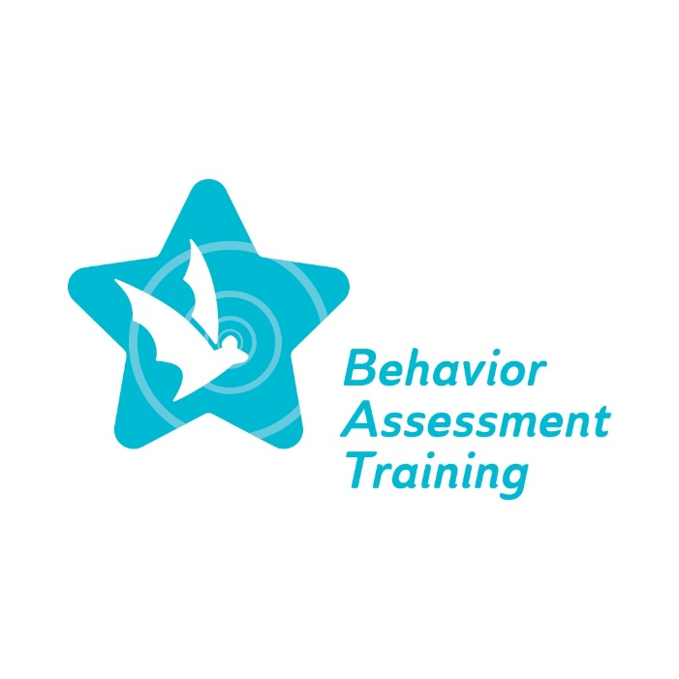
Equity ● Quality ● Collaboration ● Community

Slide 2
Viewing student behavior through an action plan
Deborah A. Bruns, Ph.D.
Michelle Connet, M.Ed.
January 18, 2023
Equity ● Quality ● Collaboration ● Community

Slide 3
Agenda
Welcome
Overview of BAT project and topic
Moving forward to a culturally responsive view of student behavior
Action plan
Preview spring 2023 webinars
Q&A (time permitting)
Exit survey
Equity ● Quality ● Collaboration ● Community

Slide 4
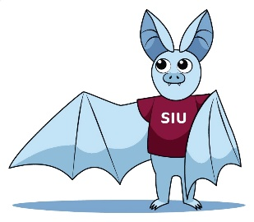
Behavior Assessment Training (BAT) project
The Special Education Behavior Assessment Training Project will provide comprehensive, professional learning for special education personnel on culturally responsive Functional Behavior Assessment (FBA) practices and Behavior Intervention Plans (BIPs) for students across all grade levels identified as having a disability in one or more of the 13 categories specified in IDEA…Additionally, the successful Offeror will coordinate with ISBE on mandate 105 ILCS5/14-8.05, which requires ISBE to develop and implement State-level guidelines on culturally responsive, evidence-based behavior interventions for students across all grade levels identified as having a disability in one or more of the 13 disability categories specified in IDEA.

Slide 5
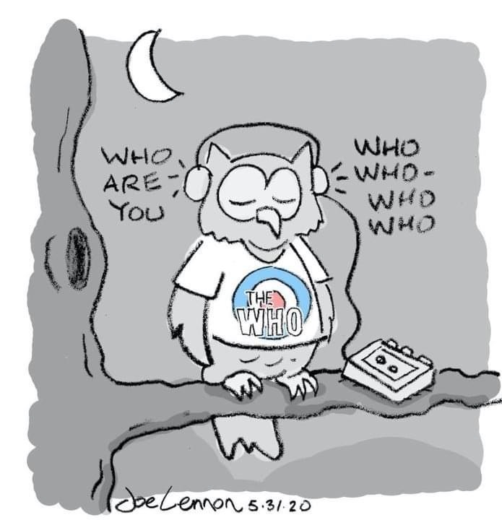
Overview of topic
Examine student behavior through a personal, contextual, and professional lens
Awareness of personal lens as a process; much is long- standing and not examined
Explore potential for mismatch in what we bring and what our students bring to the classroom

Slide 6
Moving forward to a culturally responsive view of student behavior
Being culturally responsive entails an awareness of one’s own cultural identity and the ability to learn and build on that identity from varying cultural and community norms (e.g., students and their families)
Acknowledging our own stereotypes along with ways to overcome fixed and simplified views
Acknowledging bias which causes lower expectations for specific students, which often create results to match the bias
Acknowledging behavioral expectations and the impact of the same expectations for all students, across all settings etc. and learning about adjustments to align with student’s cultural and background (family, community)

Slide 7
Equity in School Discipline video
Dr. Kent McIntosh at the University of Oregon outlines strategies for tackling disproportionality in education.
Focus on Discipline Referral Data by Race and the three specific strategies to address the data
https://pbisapps.wistia.com/medias/rnkz23b2x3

Slide 8
Poll #1: Do you agree with Dr. McIntosh?
1. Yes
2. No
3. Not sure

Slide 9
Discipline disparities: Trauma
Example from New Orleans (LA) schools
School response and resources related to trauma
Reduced impact of rewards and consequences
Need for staff development and also family and community engagement
Non-exclusionary discipline practices
Pearson, K., Marques, L., Stevens, M., & Williams, E. M. (2022). Trauma and discipline disproportionality: Treating the underlying concerns (p. 87-107) in P.A. Fenning, & M. B. Johnson, M. B. (Eds.). Discipline disparities among students with disabilities: Creating equitable environments. Teachers College Press.

Slide 10
Discipline disparities continued
Rethinking discipline of students with disabilities:
Using data and creating accountability mechanisms
Soliciting and centralizing marginalized voices
Deploying effective, equitable, and relationship-centered practices
Johnson, M., & Fenning, P. (2022). Rethinking discipline of students with disabilities: A path forward for research, policy, and practice (p. 194-207) P. Fenning, & M. Johnson (Eds.). Discipline disparities among students with disabilities: Creating equitable environments. Teachers College Press.

Slide 11
Discipline disparities (Fenning & Johnson, 2022) continued
Rethinking discipline of students with disabilities with the following recommendations:
Increased focus on prevention
Create a meaningful and culturally responsive tiered continuum of supports (link with MTSS)
Equip educators to meet students’ needs (PD)
Reexamine discipline referral processes
Review FBA procedures
Review and revise BIPs

Slide 12
Strategies for Countering Unconscious Bias in the Classroom
Inquiry: ask questions for greater understanding
Framing: examine issues from multiple perspectives
Dialogue: engage in conversations to build knowledge, tolerance, and acceptance
Reflection: willingness to change our perspectives and actions
Action: use what is learned to counter bias
Adapted from https://www.nafsa.org/ie-magazine/2020/8/4/strategies-countering-unconscious-bias-classroom

Slide 13
Social validity
An additional factor to consider related to bias and determining ways to address it is social validity, which is a behavioral concept.
A few definitions to consider:
Social validity refers to the social significance of intervention goals, social acceptability of intervention procedures, and social importance of their effects.
Social validity is concerned with measuring the impact of treatment goals, procedures, and effects on not only the direct recipients of treatment but also on others that may indirectly influenced by the treatment. Social validity assessment frequently incorporates treatment mediators, family members, friends, peer groups, etc. This inclusion in social validity assessment offers a method for measuring and ensuring that the welfare of others is considered in treatment programs.

Slide 14
Social validity continued
Need to consider how a strategy, technique, process etc. favored or adopted by one or more individuals may not be socially valid for others who are involved in addressing student behavior concerns such as
FBAs: a data collection method
BIPs: an intervention to teach replacement behavior
Collaboration with/across team members
Collaboration with parents and families

Slide 15
Items from the Assessment of Culturally and Contextually Relevant Supports (ACCReS)
Equitable Classroom Practices (13 items)
6. I engage in more positive interactions with students than negative interactions.
7. I am consistent and fair when it comes to discipline.
9. I explicitly teach students about my expectations for classroom behavior.
12. I deliver praise equitably in my classroom.

Slide 16
ACCReS continued
Consideration of Culture and Context (11 items)
5. I understand that behavior may be context specific (e.g., different behaviors may be more appropriate at home or school).
7. I self-assess my cultural biases regularly.
8. I understand that some students are at risk for being disproportionally excluded from the learning environment (e.g., sent to the office, suspended, expelled).
11. I know where to find information about culturally and contextually relevant behavior management practices.

Slide 17
ACCReS continued
Accessing Information and Support (11 items)
1. I ask families to help define my classroom expectations.
7. I request the resources (e.g., time, staff training) I need to implement culturally and contextually relevant behavior support.
8. I meet with support personnel (e.g., instructional coaches, lead teachers, consultants) to help me consider cultural and contextual factors that might affect how I support students’ behavior.

Slide 18
Poll #2: How likely are you to now focus on one or more ACCReS items in your practice?
1. Not likely
2. A little likely
3. Neutral
4. Somewhat likely
5. Very likely

Slide 19
Action plan
Select one goal and 2-3 specific objectives to reach your stated goal (refer to AACReS items)
Learn more about cultural responsivity
Learn more about your perspective on student behavior
Gain knowledge about a one or more students
Examining program, building, district behavior policies
Share your goal and objectives with a colleague to ensure follow-up and opportunity for feedback
Continue to participate in BAT project activities

Slide 20
Preview spring 2023 webinars
Topic 2:
Evidence-based behavioral interventions
Using a cultural lens to develop evidence-based FBAs
Using a cultural lens to develop evidence-based BIPs
Summary and Action plan

Slide 22
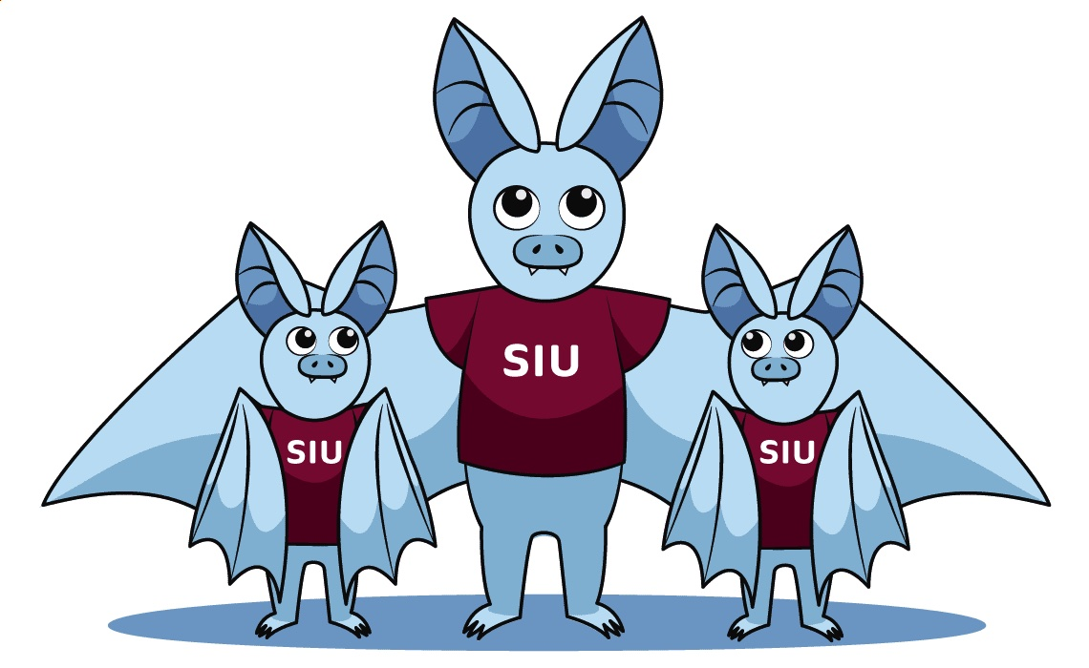
Please complete the Exit survey
Equity ● Quality ● Collaboration ● Community

