Slide 1
Culturally Responsive Behavior Intervention Plans
Louise M. Yoho, PhD
Behavior Assessment Training Program
Southern Illinois University

Slide 2
Welcome!
In this webinar will examine what it means for to have culturally responsive evidence-based behavior intervention plans
Guest speaker: Mr. Travis Clayton

Slide 3
Who are you?
Special Education Teacher
General Education Teacher
Related Services Professional
Administrator
Other

Slide 4
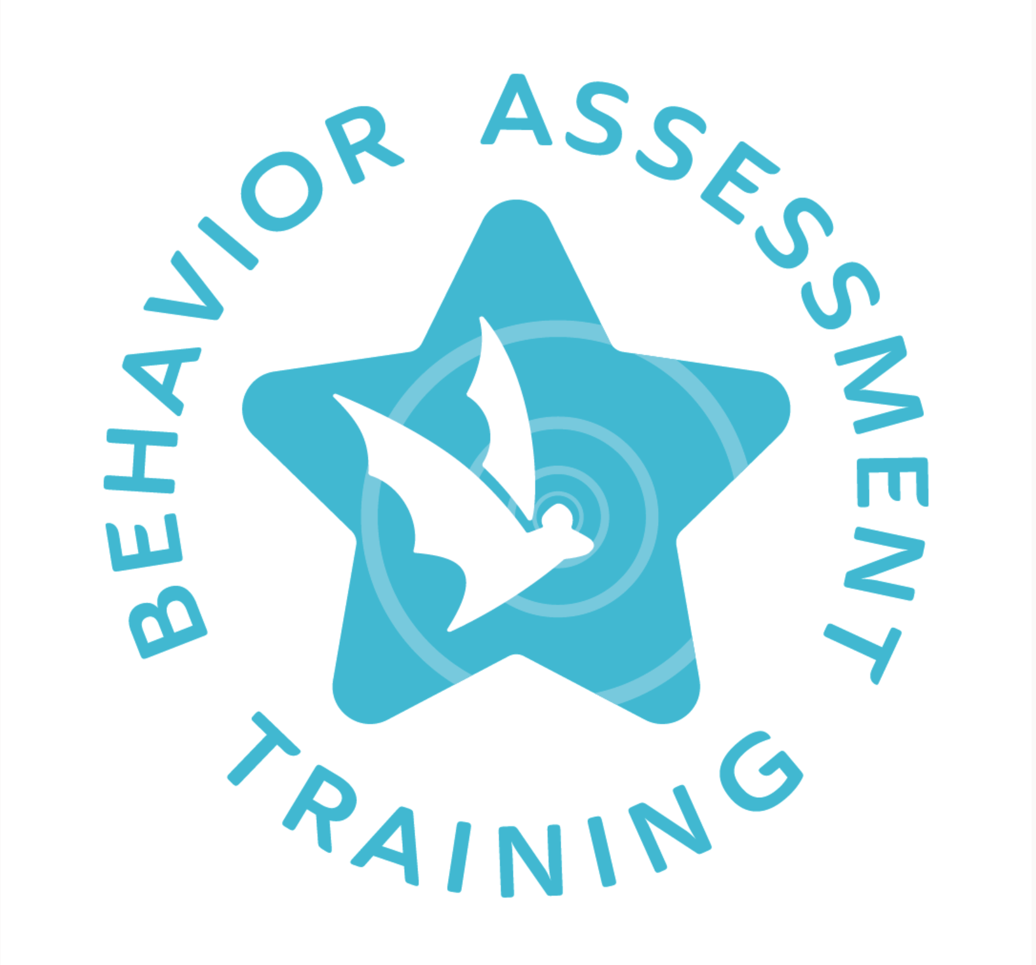
The Behavior Assessment Training (BAT) project provides professional webinars by content experts on implicit bias, culturally responsive functional behavior assessment (FBA) practices, behavior intervention plans (BIPs), the impact of trauma and other adverse circumstances, family collaboration and early childhood. This project is funded by the Illinois State Board of Education through an IDEA Part B Federal Grant.
About the BAT project
Notes:
Here is a little bit about the bat project.

Slide 5
Importance of topic
Students from historically marginalized groups are more likely than their peers to be affected by exclusionary discipline practices, like suspensions and expulsions.
Too often educators view student behavior as a problem, instead of the communication that it is.
Culturally, linguistically, and racially diverse children and youth with disabilities make up a disproportionate percentage of students who receive punitive, restrictive, and often exclusionary disciplinary actions.

Slide 6
BAT webinar schedule
Upcoming Webinars
Archived Webinars
May 17th
Expanding on major behavior management themes
August 9
Restorative Practices
September 20
Staff, Community & Family Collaboration
October 18
Impact of Trauma and Other Adverse Circumstances
November 15
Significant Behavior Needs
January 17
Court Involved Youth
February 21
Culturally Responsive Data Collection
March 20
Implementation Fidelity
April 17
Summary and General Follow-Up
May 15
Early Childhood
October (archived)
Teacher Bias & Stereotype Awareness
November (archived)
Evaluation & Bias
December (archived)
Legal/Ethical Requirements of FBAs and BIPs
January 18th (archived)
Viewing student behavior through an action plan
February 15th (archived)
Culturally Responsive Evidence-Based Behavior Interventions
March 15th (archived)
Culturally Responsive Evidence-Based FBAs
April 19th (archived)
Culturally Responsive Evidence-Based BIPs

Slide 7
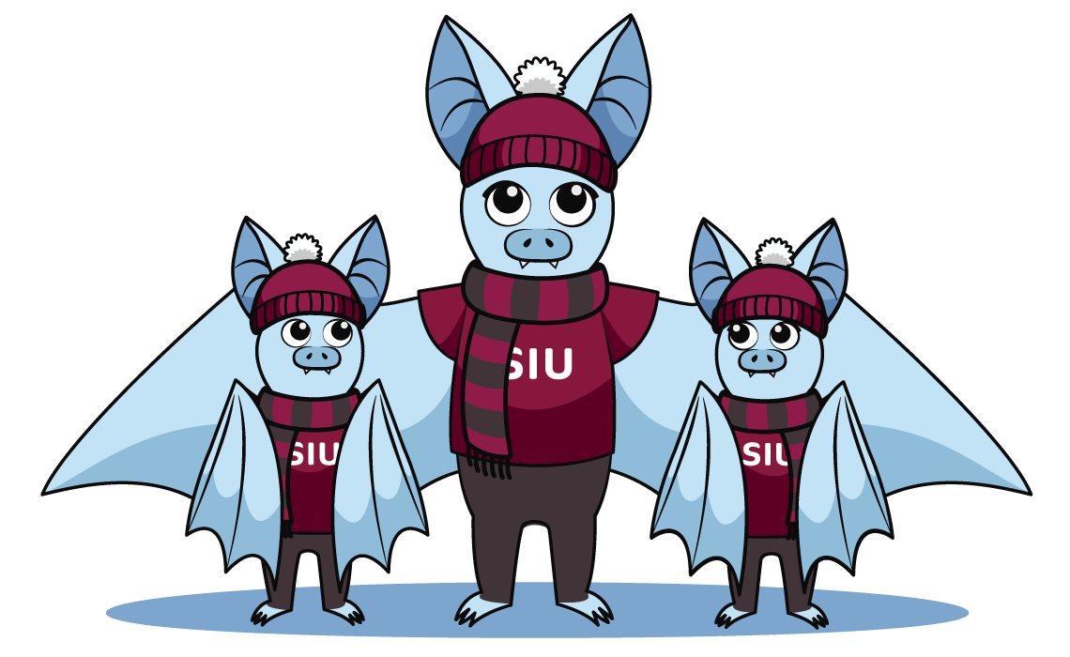
Culturally Relevant Pedagogy (CRP) by Gloria Ladson-Billings (1994): is "a pedagogy of opposition specifically committed to collective, not merely individual, empowerment.” Culturally Responsive Teaching (CRT) by Geneva Gay (2000) is used to describe "using the cultural characteristics, experiences, and perspectives of ethnically diverse students as conduits for teaching them more effectively."

Slide 8
Plan ahead
It is important that educators focus on being proactive instead of simply reactive

Slide 9
Map
The FBA is your roadmap

Slide 10
Antecedent
What comes directly before the behavior
Behavior
Consequence
Negative
Positive
What comes right after the behavior
Reinforcement
Notes:
What they are and why they are included (how they fit within the whole)

Slide 11
Antecedents
When, where, and with whom does the problem behavior occur?
What circumstances, situations, or activities lead to the problem behavior?
Are there emotional or behavioral predictors of the problem behavior?
Is the problem behavior related to medication, medical condition, pain, discomfort, problems with sleep, other biological factors, or other setting events?

Slide 12
Clearly defined behaviors
Operationally defined
What does the behavior sound like?
What does the behavior look like?
What does the behavior feel like?

Slide 13
Hypothesized need (function) is being communicated?
Attention Seeking
Communication of needs and wants
Seeking escape or avoidance
Difficult task, unfavorable setting, physical discomfort or pain, peer or staff ridicule, showing vulnerability or inability to do a task.
Sensory feedback
Blindisms, earache, sinus pain, skin irritation, hunger, constipation, fatigue

Slide 14
Performance or Skill Deficit?

Slide 15
Ask Yourself….
Does the student understand the behavioral expectations for the situation?
Is the student aware he or she is engaging in the behavior, or is it a "habit"?
Is the student physically and/or cognitively capable of controlling the behavior, or does he or she need support?
Does the student have the skills necessary to perform new behaviors?
Notes:
If the answer to any or all of these questions is “no”, it is likely a skill deficit which can be remedied through instruction and/or accommodations.

Slide 16
What do you want the student to do instead?
Would this desirable behavior fulfill the same need/function?
Is the student capable of engaging in the replacement behavior?
What prevents this behavior from occurring now?
Alternative behaviors

Slide 17
Summary of Previous Interventions Attempted
What has been tried in the past?
What were the outcomes?
What does that data tell us about reinforcement preferences?
What does that data tell us about the match between the hypothesized function and proposed replacement behaviors?
Be specific!

Slide 18
What is one thing that you struggle with when implanting a BIP?
The function of the BIP doesn’t align with the FBA.
Lack of specific teaching strategies/interventions
Deciding if it is a performance vs skill deficit
Data collection issues
BIPs are not individualized to specific student.

Slide 19
Introducing Mr. Clayton
Notes:
Mr. Travis Clayton has been an educator for over 30 years. I've spent 30 years teaching self-contained special education in majority-minority Title I districts in southern Illinois and Southeast Missouri. I've participated in the integration of a formerly all-White school. I've worked primarily with students who've been diagnosed as having behavioral/psychological/emotional disorders and/or histories of violence (whether as perpetrator, recipient, or witness--usually some combination of the three). I still love what I do.

Slide 20
Mr. Clayton discusses culturally responsive evidence-based behavior intervention plans
Notes:
When should the team decided to develop an FBA to address student behavior?
Who should be a part of that process?
What role does cultural responsiveness play in the development of an FBA?
What is the one (or two) big things educators should understand about culturally responsive evidence-based functional behavior assessments?

Slide 21
How do you and your team utilize the data collected through the FBA process to build the BIP that follows?

Slide 22
How do you identify and teach replacement behaviors? (Such that they serve the same function as the behavior identified as problematic)

Slide 23
What role does cultural responsiveness play in the development of an BIP?

Slide 24
What is the one big take-away you want educators to understand about culturally responsive evidence-based behavior intervention plans?

Slide 25
Audience questions

Slide 26
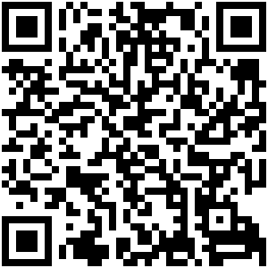
BAT webinar schedule
May 17th
Expanding on major behavior management themes
August 9
Restorative Practices
September 20
Staff, Community & Family Collaboration
October 18
Impact of Trauma and Other Adverse Circumstances
November 15
Significant Behavior Needs
January 17
Court Involved Youth
February 21
Culturally Responsive Data Collection
March 20
Implementation Fidelity
April 17
Summary and General Follow-Up
May 15
Early Childhood

Slide 27
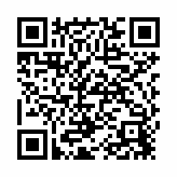
EXIT SURVEY
Please complete our exit survey either with our QR code or check your email for the link. Thanks!

Slide 28
Thank you for your participation!
This project is funded by the Illinois State Board of Education through an IDEA Part B Federal Grant.

