Slide 1
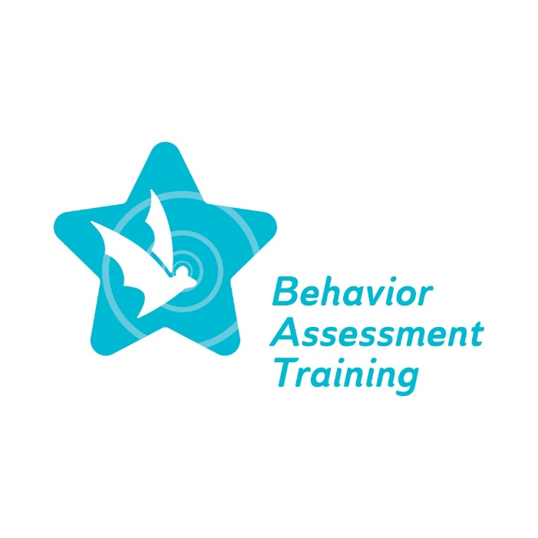
Equity ● Quality ● Collaboration ● Community

Slide 2
Staff, Community, and Family Collaboration to Address Implicit Bias
Deborah A. Bruns, Ph.D.
September 20, 2023
Equity ● Quality ● Collaboration ● Community

Slide 3
Agenda
Welcome
BAT project
Collaboration to address implicit bias including within the FBA/BIP process
Staff collaboration
Community collaboration
Family collaboration
Making a connection with collaboration and the FBA/BIP process
Self-reflection
Preview spring 2024 webinars
Exit survey
Equity ● Quality ● Collaboration ● Community

Slide 4
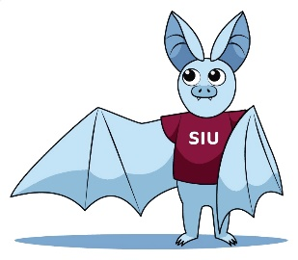
Behavior Assessment Training (BAT) project
The Special Education Behavior Assessment Training Project will provide comprehensive, professional learning for special education personnel on culturally responsive Functional Behavior Assessment (FBA) practices and Behavior Intervention Plans (BIPs) for students across all grade levels identified as having a disability in one or more of the 13 categories specified in IDEA…Additionally, the successful Offeror will coordinate with ISBE on mandate 105 ILCS5/14-8.05, which requires ISBE to develop and implement State-level guidelines on culturally responsive, evidence-based behavior interventions for students across all grade levels identified as having a disability in one or more of the 13 disability categories specified in IDEA.

Slide 5
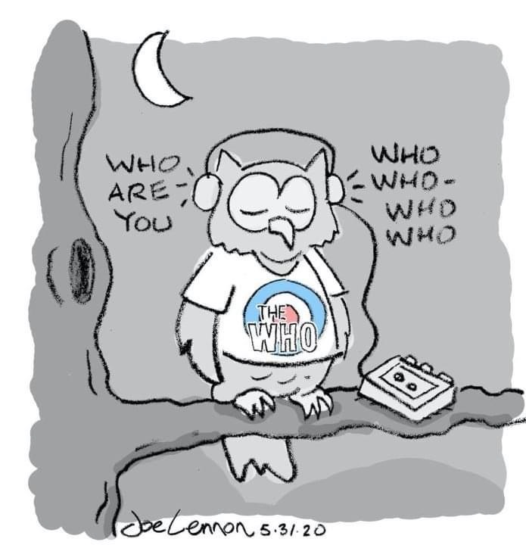
Overview of topic
Awareness of personal lens for behavioral expectations is an ongoing process
Staff, community, and family collaboration is central to understanding behavior
Consider strategies and resources to understand and meet in the middle to respond to behavior

Slide 6
Poll #1: Do you agree with the previous statements?
1. Yes
2. No
3. Not sure
4. No opinion

Slide 7
Collaboration to address implicit bias: Context for the topic
Studies of school-age children have also found that schools are more likely to suspend or expel lower income children and children with a disability. Children of color, boys, and children with disabilities are likely to be more harshly disciplined than other children for the same behaviors. They are also more likely to be disciplined for behaviors that are not well defined, such as “having a bad attitude.”
Our implicit biases often come out when we must make quick decisions under stress, and we may end up relying on unconscious stereotypes. Implicit biases become harmful when they affect decisions made about how children are treated at school, which in turn affects their chances at succeeding in school and later in life. By working to consciously and intentionally recognize and overcome our biases…will help all children succeed and help reduce suspensions and expulsions, especially for boys, children of color, and children with disabilities.
https://preventexpulsion.org/1g-provide-professional-development-and-ongoing-support-for-all-program-staff-on-culturally-responsive-practices-and-implicit-bias/

Slide 8
Staff collaboration to address bias
Being culturally responsive entails an awareness of one’s own identity and the ability to learn and build on that identity by drawing from an understanding of students and their families
Being culturally responsive includes an understanding of community norms, values, and practices
Acknowledging behavioral expectations and the impact of the same expectations for all students, across all settings etc. and learning about adjustments to align with student’s background (cultural, family, community); identify and acknowledge own “blind spots”
Acknowledging bias/biases which cause lower expectations for some students, which often create results to match the bias including to conduct an FBA and in the BIP process

Slide 9
Staff collaboration continued
Examination and recognition of each staff member’s values related to equity and diversity
Examination of interpersonal communication and problem solving
Examination of top-down and bottom-up systems and processes
Examination of the impact of the three above areas on behavioral expectations for students with disabilities; assumptions about students’ learning behaviors and their capability for academic success, which are tied to students’ identities and/or backgrounds. These assumptions can impede student growth and achievement (Staats, et. al, 2017) along with potential impact on conducting an FBA and in the BIP process
Staats C. et al. (2017). State of the Science: Implicit Bias Review 2017. Kirwan Institute for the Study of Race and Ethnicity.

Slide 10
Community collaboration
Awareness of community programs, organizations and resources and their scope, expectations, and outcomes for families; may be at odds with staff (familiarity/understanding, experiences)
Outreach to community leaders to work together for students and their families in culturally responsive ways
Need for leadership and capacity building for all involved as well as ongoing evaluation efforts to improve understanding and actions

Slide 11
Community collaboration continued
Community should extend beyond neighborhoods where students' homes and schools are located but also any neighborhoods and affiliations that influence their learning and development.
Community is more than low or high social or economic status. Focus on strengths and talents to support students, families, and schools.
Awareness of community context can assist school professionals to conduct an FBA and in the BIP process
Brion, C. (2020). Implicit bias: An unconscious barrier to family engagement. Journal of Interdisciplinary Education, 16(1).

Slide 12
Poll #2: Community collaboration
What does community collaboration mean to YOU?
Learn about history and context
Delve into culture and traditions (formal/informal)
Address disparities rather than make comparisons
Perspective of learning rather than assuming
Focus on commonalities rather than differences

Slide 13
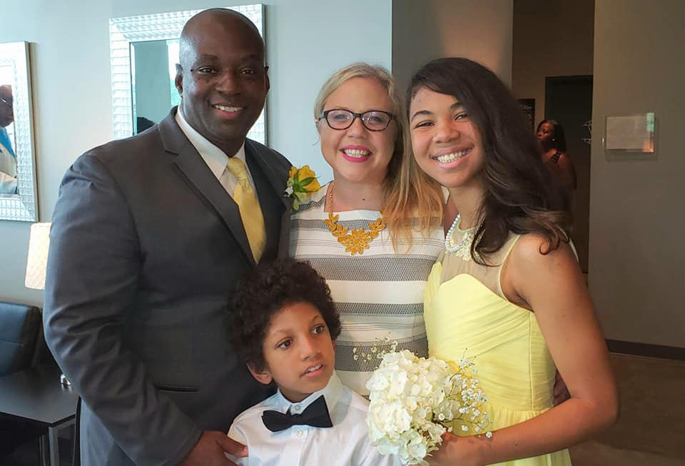
Family collaboration
Meet families “where they are” to get to know “who they are”
Work with families to identify strengths; rather than a focus on needs and deficits
Learn about behavioral expectations within family context and at community level(s); can assist to conduct an FBA and in the BIP process

Slide 14
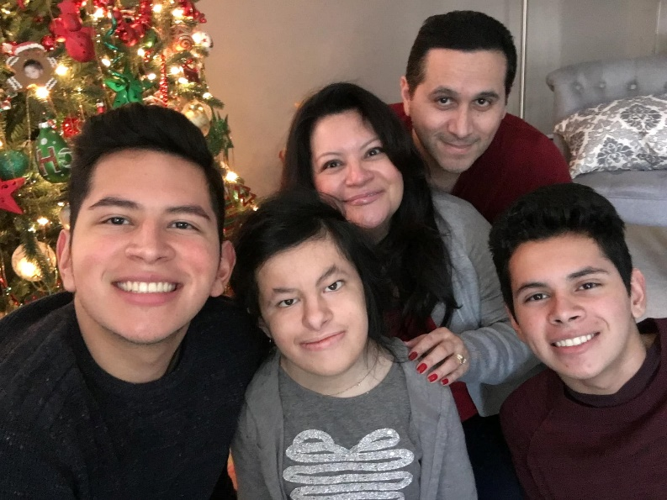
Family collaboration continued
Strive for partnerships
Learn about values and priorities
Learn about information and support needs
Work together for valued student outcomes
Pacino, M. A., & Warren, S. R. (2023). (Eds) Building culturally responsive relationships among schools, families, and communities. Teachers College Press. New York, NY.

Slide 15
Bronfenbrenner’s ecological framework

Slide 16
Levels of the framework
All levels require interaction and impact collaboration
Microsystem focuses on the student’s context
Mesosystem focuses on communication
Exosystem focuses on outside influences
Macrosystem focuses on societal context
Chronosystem focuses on passage of time

Slide 17
Strategies for collaboration
Encourage and facilitate opportunities to interact with individuals and groups from other races, cultures, ethnicities, ages, socioeconomic statuses, sexual identities, religions, genders, and abilities.
Raise awareness of biases along with ways to replace and reframe through open-mindedness, knowledge, and interactions
Identify training / professional development needs and collaboratively plan to address them in an ongoing manner and invite feedback / evaluation

Slide 18
Strategies for collaboration continued
Keep up to date as staff members change, new programs are available, new groups in community etc.
Continue to self-evaluate and work with others to make changes related to implicit bias and behavioral expectations especially to conduct an FBA and in the BIP process
Be intentional about collaboration

Slide 19
Poll #3: How likely are you to implement one or more of the strategies for collaboration?
1. Not likely
2. A little likely
3. Neutral
4. Somewhat likely
5. Very likely

Slide 20
Poll #4: Which strategy for collaboration are you likely to implement?
Encourage/facilitate opportunities to interact
Raise awareness of biases
Identify training/professional development needs
Keep up to date with community organizational changes
None of the above

Slide 21
Making a Connection
Understanding behavioral expectations within family and community contexts is crucial when conducting a Functional Behavior Assessment (FBA) and creating a Behavior Intervention Plan (BIP). This involves ongoing self-evaluation and collaboration to combat implicit biases that might influence these processes, particularly in terms of setting lower expectations for specific students.
Recognizing the importance of community context is essential for school professionals to conduct successful FBAs and BIPs, as unfounded assumptions can impede student growth and achievement.

Slide 22
Self-reflection
How can staff foster and nurture collaboration with families when racial, cultural and/or economic capital are limited?
How can staff foster and nurture a family’s cultural values and goals for adulthood for their child when there are differences or disagreements? How can the future be co-constructed?
How do we not “judge a book by its cover”?
Harry, B. & Ocasio-Stoutenburg, L. (2020). Meeting families where they are: Building equity through advocacy with diverse schools and communities. Teachers College Press. New York, NY.

Slide 23
Preview spring 2024 webinars
February 2024: Culturally responsive data collection
March 2024: Implementation fidelity
April 2024: Creating an action plan
May 2024: Early Childhood

Slide 24
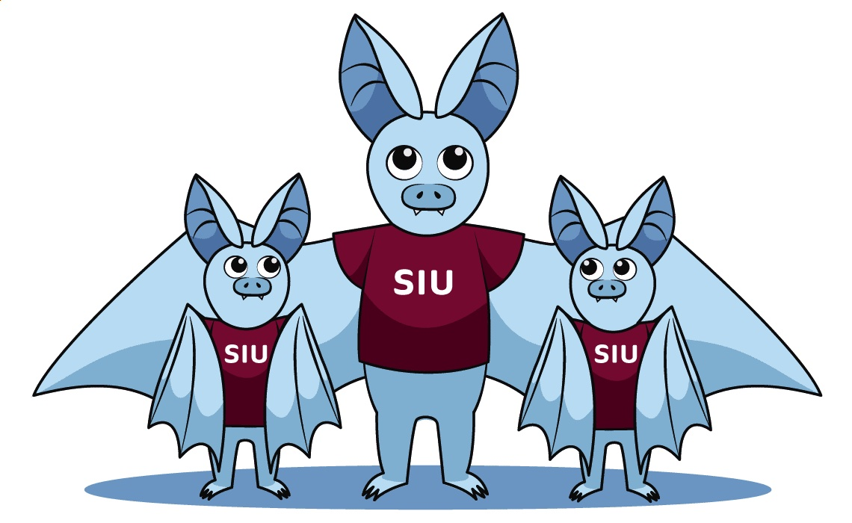
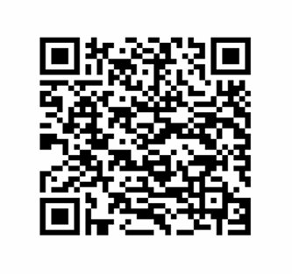
Please complete the Exit survey
Equity ● Quality ● Collaboration ● Community

