Slide 1
Trauma-related supports for students with significant disabilities
Dr. Jessica Zanton Eastern Illinois University

Slide 2
Agenda
What is trauma? What is traumatic?
How does trauma impact the educational experiences individuals with ASD and I/DD?
What are some effective practices for supporting students who have experienced trauma?
Notes:
This presentation will explore trauma as it impacts individuals with disabilities, specifically those with ASD and I/DD, and how educators and other service providers can incorporate trauma-informed practices into their own professional practices. This will be done with a special lens towards diversity, equity, inclusion, and belonging, with a specific focus on belonging.

Slide 3
Session Outcomes
After attending this presentation, participants will
1) be knowledgeable about the impacts that trauma has in the lives of students
2) understand the different ways in which trauma can manifest
3) will know how to locate supports for implementing trauma informed practices, both in schools and in disability related service organizations.

Slide 4
Welcome!
Jessica Zanton, PhD
Assistant Professor
Eastern Illinois University

Slide 5
What is trauma?
“An event, a series of events, or a set of circumstances that is experienced by the individual as physically or emotionally harmful or life threatening”
An objective AND subjective experience
The greater the perception of threat to life, bodily integrity, or sanity, in response to an event, the greater the experience of trauma
(McNally, 2021; SAMHSA, 2014)

Slide 6
Subjectivity
“It’s not the objective facts that determine whether an event is traumatic, but the person’s subjective emotional experience of the event.”
Notes:
Feeding tube example

Slide 7
What is trauma?
Type 1—single incident
Type 2—complex/developmental trauma
Sustained over time
Usually in childhood
Usually by someone in a close relationship
Escape is “difficult or impossible”
(Reed et al., 2016)

Slide 8
What is Traumatic?
Witnessing Violence
(personal, domestic, community)
Abuse
(physical, sexual, psychological)
Neglect
(physical, social, emotional)
Loss
(freedom, mobility, close person, health)

Slide 9
Poll: How were you made aware of traumatic events that have impacted your students?
Parents shared about prior trauma.
Students shared about prior trauma.
IEP indicated prior trauma.
Other
None of the above.

Slide 10
What is traumatic?
Little T:
stressful events that affect our physiology and neurology
(bullying, neglect, exposure to violence)
Big T:
life-threatening events
(war, rape, torture)
(Blout & Roosa, 2020)

Slide 11
Early Trauma Has Lasting Impacts

Slide 12
Notes:
Injury, Mental Health, Maternal Health, Infectious Disease, Chronic Disease, Risky Behaviors, Opportunities

Slide 13
The CDC-Kaiser Permanente adverse childhood experiences (ACE) study

Slide 14
Adverse Childhood Experiences
Adverse Childhood Experiences (ACE) Study
Having a family member attempt or die by suicide
Growing up in a household where there is:
-Substance abuse
-Mental health problems
-Parental separation
-Household members in jail/prison
(Blout & Roosa, 2020)

Slide 15
What did the ACEs Study Show?
61% of adults across 25 states reported at least one type of ACE
1 in 6 reported four or more types of ACEs
Having 4+ ACEs increases chances of chronic health, mental illness, and substance abuse problems in adulthood
“Emotional” problems have “physical” impacts
(Blout & Roosa, 2020)

Slide 16
Why are children at Risk?
Young children perceive different events as life-threatening
Children have less power and control over their lives
Trauma to developing brains alters the youth’s development
(Blout & Roosa, 2020)

Slide 17
The Impact of Trauma
Body is on the lookout for danger (triggers)
Arousal “set-points” are fixed (too much, too little)
Distortion to the perceptions of people and events
Limited capacity for flexible thinking and creative problem solving
Physical discomfort symptoms
(Blout & Roosa, 2020)

Slide 18
traumas and Individuals with ASD and I/dd

Slide 19
Trauma and disability
Youth with disabilities experience higher rates of traumatic events than their peers.
Children with autism spectrum disorder and learning disabilities have higher risks for maltreatment (MacDonnell et al., 2019)
The Spectrum Institute (2013) found that 70% of respondents with disabilities reported being victim of abuse, and of those, 90% had experienced abuse multiple times.
Women with intellectual disabilities who are in relationships “are much more likely to have been sexually assaulted and/or forced into unwanted sexual activity” (Skelly, 2021, p. 2).

Slide 20
Intellectual disabilities
Level of ID influences expression of symptoms
Trauma is expressed behaviorally and emotionally, rather than cognitively
Trauma results in significantly increased rates of aggression, self-injurious behaviors, psychological stress
For those with severe/profound ID: the key signs of abuse included a ”deterioration of adaptive skills and behavior immediately following the abuse”
(Mason-Roberts et al, 2018; Rittmansberger et al., 2019)

Slide 21
Intellectual disabilities
The experience of living with a significant disability can lead to experiences perceived as traumatic:
Limited self-determination skills
Limited emotional regulation skills
Not able to predict harm as easily
Needing support from others
Feeling different
(McGilvery, 2018; McNally, 2021)

Slide 22
autism
People with autism have an increased risk of traumatic experiences (increased ACEs)
Children with autism have more than double the risk of youth protective services referrals – but reports are less likely to be investigated
3-4 times more likely to be bullied (40-90% of children with autism, compared to 40% of neurotypical children)
(Blout & Roosa, 2020; McNally et al., 2021))

Slide 23
autism
If the definition of trauma is loosened “to include stressful life events, for example, parental divorce/separation or failing a school test”…
+50% ASD reported traumatic event in their lifetime that was interpreted as traumatic
(Taylor & Gotham, 2016)

Slide 24
autism
“In speaking with people with ASD about traumatic experiences, Dr. Kerns has heard ‘everything from sexual abuse, emotional abuse and horrendous bullying, to much broader concepts, like what it’s like to go around your whole life in a world where you have 50% less input than everyone else because you have social deficits. Or feeling constantly overwhelmed by sensory experience – feeling marginalized in our society because you’re somebody with differences.’”
(Blout & Roosa, 2020)

Slide 25
autism
Peri-Trauma factors: overwhelming fear response, visual and detail-focused processing (especially of sensory features)
Post-trauma factors: negative/catastrophic appraisals, ruminations, suppression, avoidance, social withdrawal, emotional regulation
(Rumball, 2020)

Slide 26
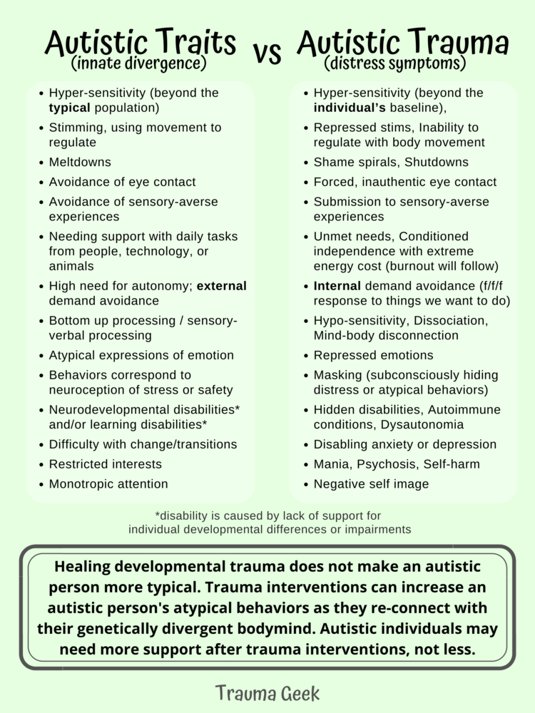
(Janae Elisabeth, 2022)

Slide 27
Educational impacts

Slide 28
What Does This Look Like in the Classroom?
Attention Problems and Executive Functioning Problems
Diminished Language Competency
Behavioral Dysregulation
Anxiety, Depression, Self-Injurious Behaviors
Learning Issues
Social Skills Difficulties
Compliance
Dissociation

Slide 29
Trauma and Behavior
Individuals who have experienced trauma can exhibit behaviors that can be disrupting in school settings, property destruction, noncompliance, aggression, or escape behaviors.
These behaviors can even look like mental health disorders, like obsessive behavior, paranoia, or schizophrenia.
In reality, students are dealing with a form of Post-traumatic Stress Disorder and should be treated by educators as such.

Slide 30
Behavior responses as traumatic events
Negative interactions with trusted adults
Contact with law enforcement
Seclusion
Restraint
Suspension & expulsion
Incarceration
Isolation

Slide 31
So…Now What Do We Do?
Teach skills:
Academic
Executive Functioning
Social Behaviors
Emotional Behaviors
Build Resiliency:
Psychosocial support (caregiver and community)
Sense of mastery
(Blout & Roosa, 2020)

Slide 32
Being Trauma-informed
Trauma-informed practices are not a specific set of actions, but a rather a set of services, supports, and principles rooted in empathy. Trauma-informed practices shift the focus of interventions from “What’s wrong with you?” to “What happened to you?”

Slide 33
How About in Schools?
Consider the youth’s learning profile
Be sensitive to the youth’s stress-response style (fight, flight, freeze?)
Direct approach to stress response—validation and modification, not “don’t worry”
Remember when youth go into survival mode (triggered), they cannot access higher-level skills, like language
Teach youth to identify their emotional state and be self-advocates
Avoid isolated time out and physical restraint
(Blout & Roosa, 2020)

Slide 34
Ecological Fit
Enhance the environment-person relationships
reduce isolation, support social competence, coping skills, and belongingness in social contexts
Interventions last by becoming embedded in social settings and community contexts
Often school environments offer special education services but no ecological fit
pullout sessions, no training on neurodiversity—isolation
(Blout & Roosa, 2020)

Slide 35
Neurodiversity-Affirming Approaches
Modify the environment and provide supports rather than the student having to change
View challenges as problems to be solved
Understand and teach self-regulations skills
Help students identify sensory processing/soothing techniques
Have spaces without “visual noise”
Present information visually
(Kircher-Morris, 2021; SLP Now, 2022)

Slide 36
Neurodiversity-Affirming Approaches
Provide options for individual or group work
Provide explicit expectations for all tasks
Encourage respect and understanding from NT peers
Honor multiple ways to demonstrate understanding
Have patience for slow processing
(Kircher-Morris, 2021; SLP Now, 2022)

Slide 37
poll: how will the information you learned today impact future interactions with your students?
Teach coping and self-regulation strategies
Provide a calming area for students
Make positive connections with students
All of the Above
Other

Slide 38
Resources

Slide 39
Where to find resources
PACEs
https://www.pacesconnection.com/g/aces-in-education/blog/resource-list-trauma-informed-approaches-and-autism-spectrum-and-other-developmental-disabilities-1
Traumatic stress institute
https://www.traumaticstressinstitute.org/trauma-and-developmental-disabilities/
Trauma Geek
https://www.traumageek.com/
StimPunks
https://stimpunks.org/space/human/
ASCD
https://www.ascd.org/el/articles/supporting-students-with-disabilities-in-trauma-sensitive-schools

Slide 40
Your thoughts and experiences? Questions?

Slide 41
Contact information
Jessica Zanton, PhD
Department of Special Education
Eastern Illinois University Charleston, IL
jjzanton@eiu.edu

Slide 42
References
Blout, S.M., & Roosa, N. (2020, March 19). Autism and trauma: The intersection. https://www.aane.org/wp-content/uploads/2019/12/Nancy-Roosa-Stephanie-Monaghan-Blout-Autism-Trauma.pptx
Janae Elizabeth. (2022, May 12). Autistic traits vs Autistic trauma. https://www.traumageek.com/polyvagal-neurodiversity-blog-project/autistic-traits-and-trauma
Kircher-Morris, E. (2021). The neurodiversity-affirming classroom. https://waetag.com/wp-content/uploads/2022/01/WAETAG-Neurodiversity-Affirming-Classroom.pdf
Mason-Roberts, S., Bradley, A., Karatzias, T., Brown, M., Paterson, D., Walley, R., Truesdale, M., Taggart, L., & Sirisena, C. (2018). Multiple traumatization and subsequent psychopathology in people with intellectual disabilities and DSM-5 PTSD: A preliminary study. Journal of Intellectual Disability Research, 63, 1-7.
McGilvery, S. (2018). The Identification and Treatment of Trauma in Individuals with Developmental Disabilities. NADD Press.
McNally, P., Taggart, L., & Shevlin, M. (2021). Trauma experiences of people with an intellectual disability and their implications: A scoping review. Journal of Applied Research in Intellectual Disabilities, 34, 927-49.
Reed, G. M., First, M. B., Elena Median-Mora, M., Gureje, O., Pike, K. M., & Saxena, S. (2016). Draft diagnostic guidelines for ICD-11 mental and behavioral disorders available for review and comment. World Psychiatry, 15, 112-113.
Rittsmannberger, D., Yanagida, T., Weber, G., & Lueger-Schuster, B. (2020). The association between challenging behavior and symptoms of post-traumatic stress disorder in people with intellectual disabilities: A Bayesian meditation analysis approach. Journal of Intellectual Disability Research, 64, 538-550.
Rumball, F., Happe, F., Grey, N. (2020). Experience of trauma and PTSD symptoms in autistic adults: Risk of PTSD development following DSM-5 and non-DSM-5 traumatic life events. Autism Research, 13, 2122-2132.
SLP Now. (2022). How to use neurodiversity-affirming practices to build relationships with students. https://blog.slpnow.com/how-to-use-neurodiversity-affirming-practices-to-build-relationships-with-students/
Taylor, J. L., & Gotham, K. O. (2016). Cumulative life events, traumatic experiences, and psychiatric symptomatology in transition-age youth with autism spectrum disorder. Journal of Neurodevelopmental Disorders, 8.

