Slide 1
Troubleshooting Reinforcement
Cori M. More, Ph.D., BCBA
Jennifer Buchter, Ph.D., MSW

Slide 2
Overview
Define Reinforcement
Necessary Components of Reinforcement
Where it “falls apart”
Checklist of strategies to try

Slide 3
Why Do You….

Slide 4
We Usually Get a Pay Off
Get Something
Positive Reinforcement
Get Away From Something
Negative Reinforcement

Slide 5
Reinforcement
Positive Reinforcement
Something Added to increase a behavior
Negative Reinforcement
Something Taken away to increase a behavior

Slide 6
Reinforcement
Create conditions for behavior change
Used to teach new skills
Immediately for New Skills
Specific Behavior
Contingent upon a Behavior Occurring
Not Bribing

Slide 7
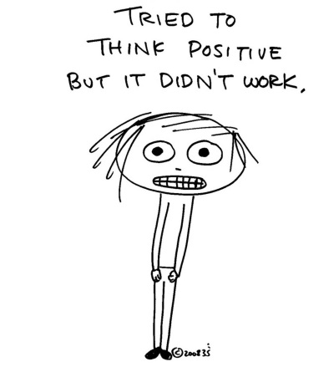

Slide 9
Where Does Reinforcement Fall Apart?
Preference Assessment
Powerful Reinforcers
Non-contingent Reinforcement
Schedule of Reinforcement
Data Collection

Slide 10
Preference Assessment
Observation
Parent / Teacher Interviews
Ask the Student
Paired Choice
Can Change over time

Slide 11
Preference Assessment Research
Survey with Words Only: Good at identifying preferred items
Survey with Words and Pictures: Better at identifying preferred and non-preferred (Northrup et al., 1996)

Slide 12
Powerful Reinforcers
Too Powerful
Not Powerful Enough
Changes
Not Enough Reinforcers
Reinforcer Not Allowed

Slide 13
Powerful Reinforcers
PROBLEMS
Too Powerful
Not Powerful Enough
Changes
Not Enough Reinforcers
Reinforcer Not Allowed
SOLUTIONS
Reinforcer Assessment
Pair with Other Reinforcers
Remove Reinforcer if Too Powerful
Offer Choice
Remove Systemic Barrier

Slide 14
Non-Contingent Reinforcement
Routine
Different Settings
Different Expectations
Peers
Life/Hard Choices
Satiation

Slide 15
Non-Contingent Reinforcement
Solutions
Change Routine (Premack)
Plan Ahead in Each Setting
Communicate
Teach Peers/Seating Changes
Be conscious about these choices
Focus on Long Term Outcome

Slide 16
Discussion

Slide 17
Schedules of Reinforcement
Continuous
Partial
Ratio
Interval
Fixed
Variable
Fixed
Natural

Slide 18
Schedules of Reinforcement
Problems:
Not Frequent enough for initial skills
Not Systematic in Fading
Forget to take/use data
Wait to long (Tokens)
Based on Teacher Need not student need
Universal rather than Individualized

Slide 19
Schedules of Reinforcement
Problems:
Solutions
Not Frequent enough for initial skills
Not Systematic in Fading
Forget to take/use data
Wait to long (Tokens)
Based on Teacher Need not student need
Universal rather than Individualized
Develop a Plan
Use Data
Individualize
Revise as Needed
Work Fade

Slide 20
Discussion

Slide 21
Data Collection
Who
Someone Responsible
What
Behavior
Reinforcer Assessment
Reinforcer Selection/Administration

Slide 22
Data Collection
When
Targeted time
Where
Anywhere behavior occurs
How
Paper
Online
Why
Track Progress
Fidelity

Slide 23
What Do You See Happening in Your Experience?

Slide 26
Contact Us
Cori More
cmmore@eiu.edu
Jennifer Buchter
jmbuchter@eiu.edu

