Slide 1
Stop the Drop

Slide 2
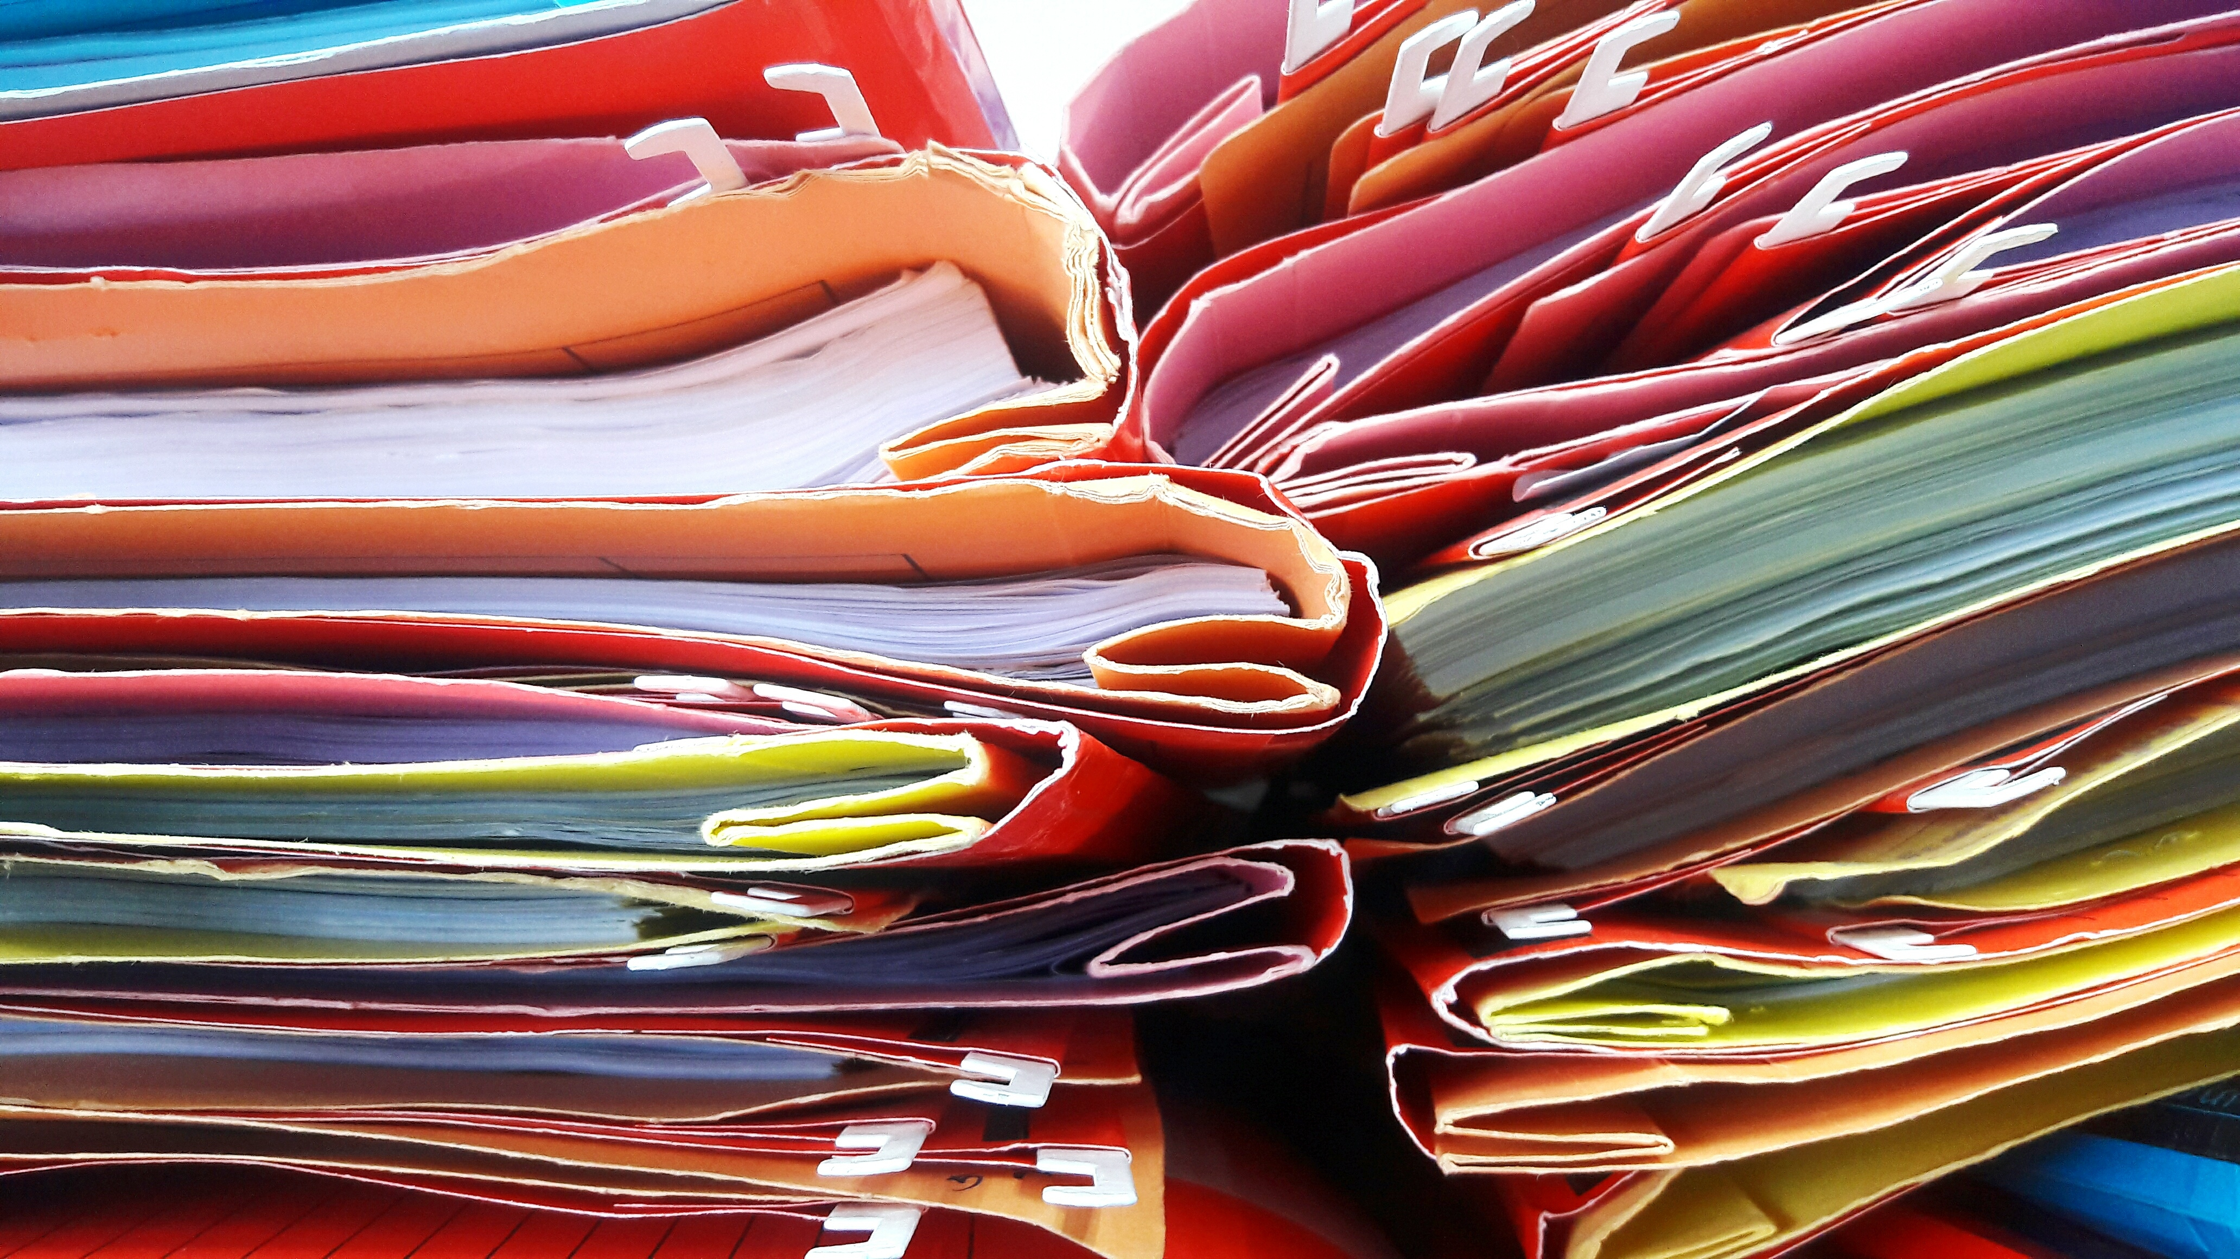
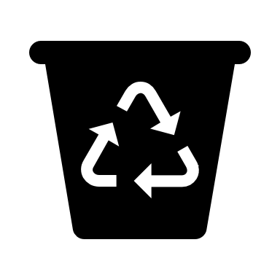
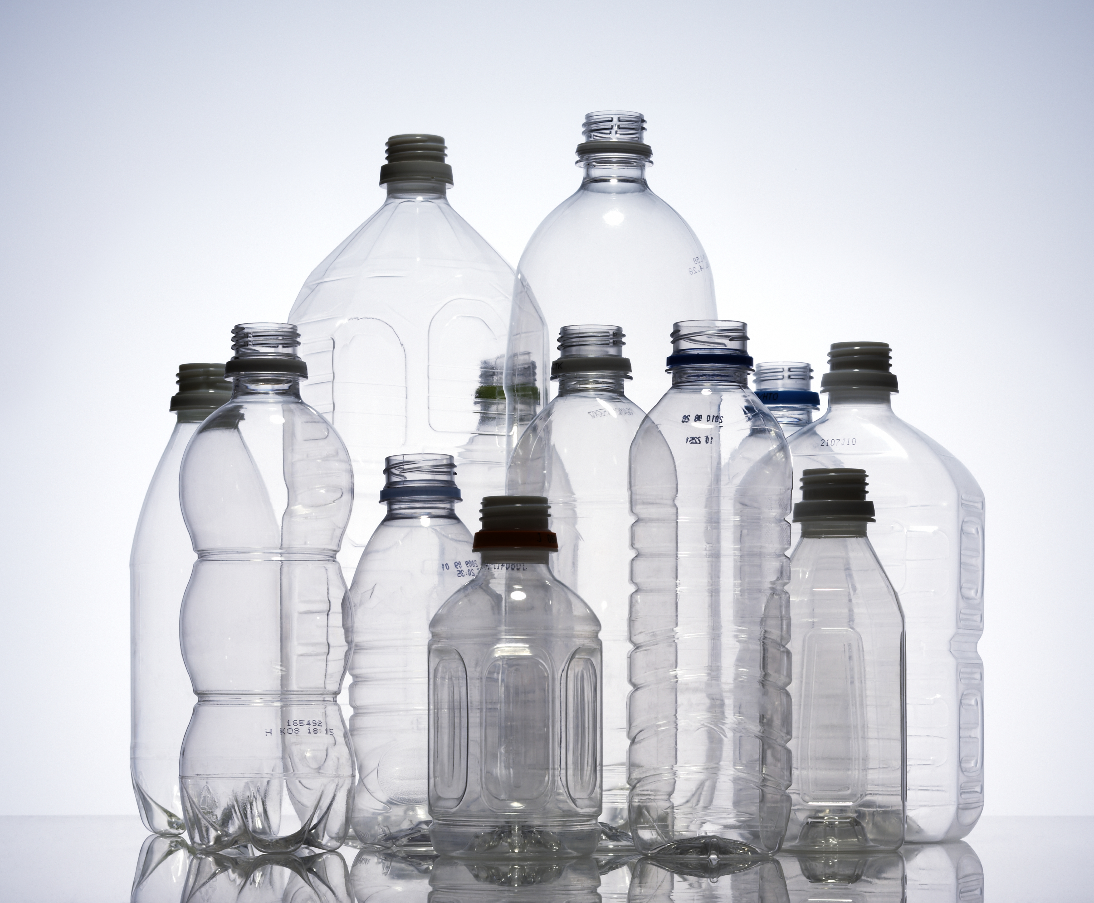
Who recycles?
Where do you take your recycling?

Slide 3
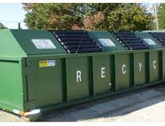
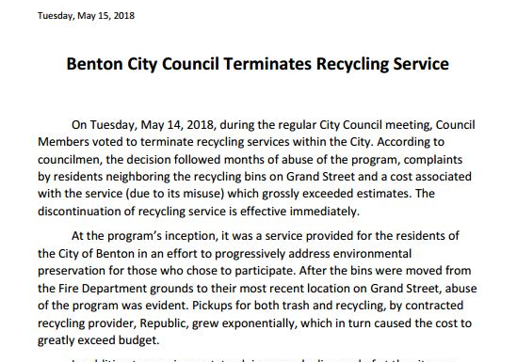
Benton, IL
What would you do?
Notes:
The city of Benton used to have a recycling program. However, in 2018, the program was cancelled because it was too expensive for the city to maintain.

Slide 4
Do Your Part Recycling
Notes:
A concerned citizen, Andy Lamont, was really concerned that the closest recycling services were located in Carbondale. That's about a 45 minute drive.

Slide 5
Solutions to Problems
Andy Lamont, a Benton community member, started taking recycling from friends and family to Carbondale.
More and more people wanted to recycle
Using his family store's warehouse and cardboard bailer, he started recycling more and more.
Now Do Your Part Recycling is responsible for 10% of all recycling Franklin County.

Slide 6
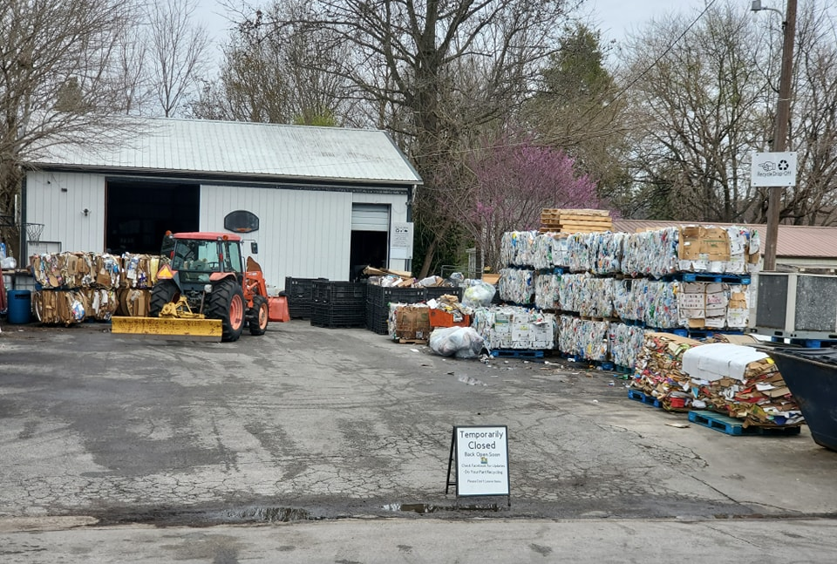
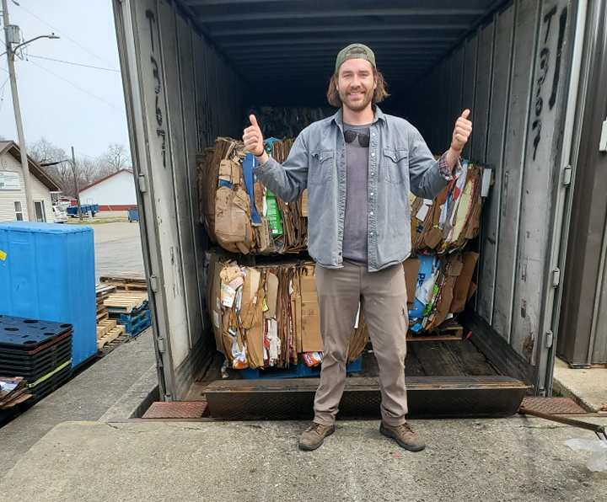
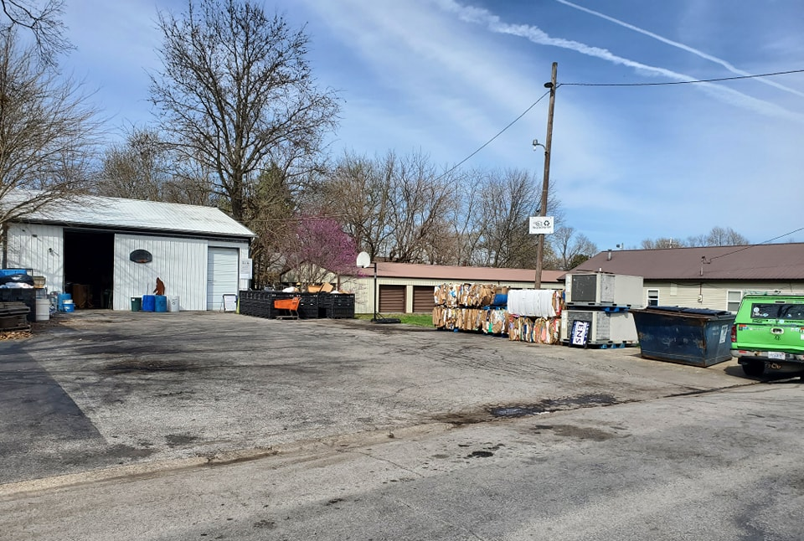
Notes:
Here you can see Andy's set-up. The top photo on the left is before loading the recycling in a semi-truck. The bottom photo on the left is a after photo with only a few bails remaining. Andy stands in front of the loaded semi-truck on the right.
Challenges that Andy have faced include the fact that it is that the cost of running this business is high. He is currently looking for grant funding to further support his program. Andy also states that if it weren't for his family's grocery store business, he would not be able to run this program. It is only because he access to a bailer and the warehouse that he has been able to sustain this program.

