Slide 1
To Biodegrade or To Not Biodegrade

Slide 2
Do we know another word that could be used to describe if an object can or cannot break down?
Notes:
Does anyone know another word we could use to describe something that breaks down and rot?

Slide 3
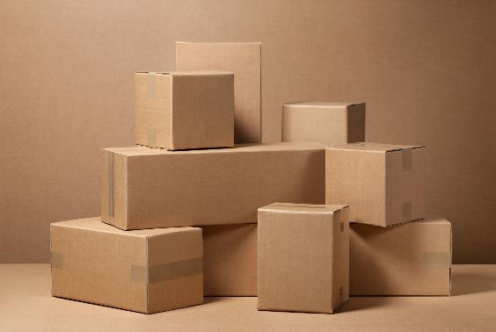
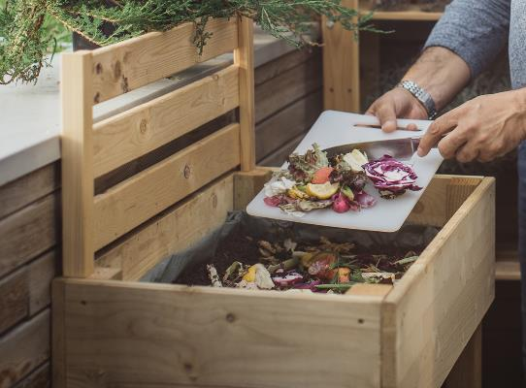
Biodegradable

Slide 4
Features of Biodegradable Items
Made up of natural materials
As materials are broken down, they turn into smaller, non-toxic parts.
Natural materials can be broken down quickly by decomposers, animals and plants.
Examples: Paper, wood, food scraps can break down to turn into healthy soil

Slide 5
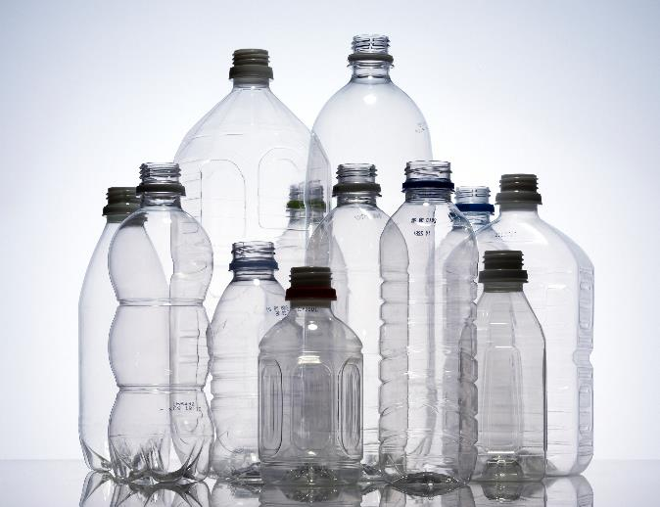
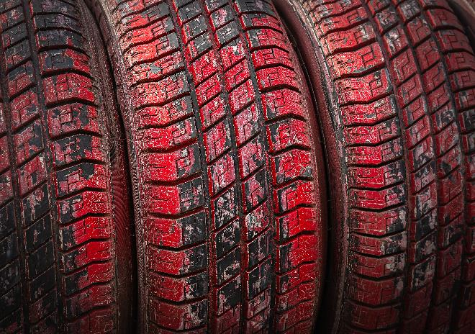
Non-Biodegradable

Slide 6
Features of Non-Biodegradable Items
Made up of man-made, synthetic materials
Materials cannot be broken down by decomposers, plants or animals.
They can be toxic and are a source of pollution.
Examples: Plastic, tires, aluminum cans, glass, metals, Styrofoam, etc.

