Slide 1
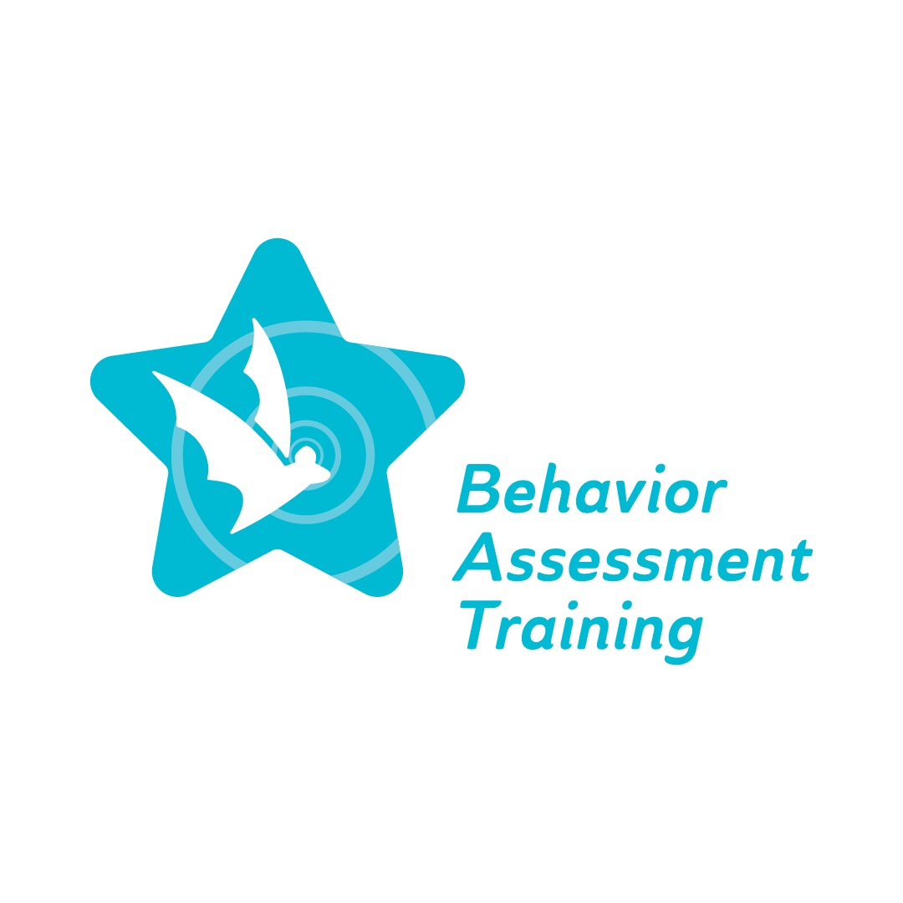
Equity ● Quality ● Collaboration ● Community

Slide 2
Overview of Implicit Bias
Deborah A. Bruns, Ph.D.
November 29, 2022
Winter Conference
Equity ● Quality ● Collaboration ● Community

Slide 3
Agenda
Welcome
Overview of BAT project
Cultural responsivity poll
Implicit bias
Key definitions related to implicit bias
Irrefutable influence
Assumptions
Discipline disparities
Strategies to counter implicit bias including social validity
Self-reflection
Q&A
Exit survey
Equity ● Quality ● Collaboration ● Community

Slide 4
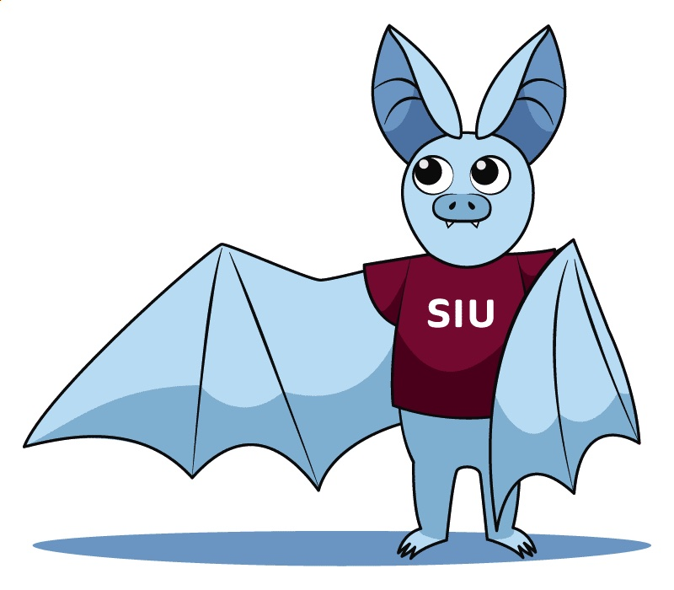
Behavior Assessment Training (BAT) project
The Special Education Behavior Assessment Training Project will provide comprehensive, professional learning for special education personnel on culturally responsive Functional Behavior Assessment (FBA) practices and Behavior Intervention Plans (BIPs) for students across all grade levels identified as having a disability in one or more of the 13 categories specified in IDEA…Additionally, the successful Offeror will coordinate with ISBE on mandate 105 ILCS5/14-8.05, which requires ISBE to develop and implement State-level guidelines on culturally responsive, evidence-based behavior interventions for students across all grade levels identified as having a disability in one or more of the 13 disability categories specified in IDEA.

Slide 5
Poll: Rate your cultural responsivity
1. I demonstrate a great deal more cultural responsivity compared with others
2. I demonstrate more cultural responsivity compared with others
3. I demonstrate less cultural responsivity compared with others
4. I do not demonstrate cultural responsivity
5. I am unfamiliar with cultural responsivity

Slide 6
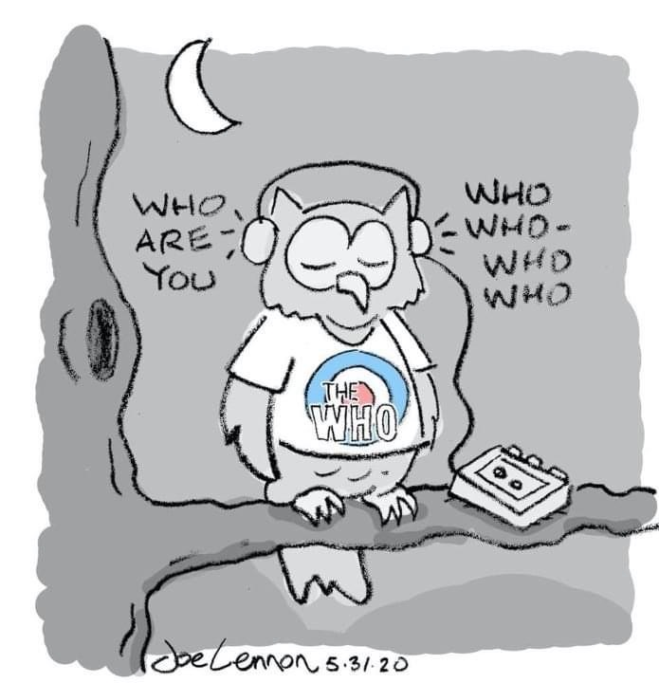
Implicit bias
Examine student behavior through a personal, contextual, and professional lens
Awareness of personal lens as a process; much is long- standing and not examined
Explore potential for mismatch in what we bring and what our students bring to the classroom

Slide 7
Consider the similarity between preferred learning modality and implicit bias
What if there is a mismatch in your preferences and one or more of a student’s preferred learning modality?
What is the potential impact on academic success?
What is the potential impact on behavioral expectations?
We also need to consider implicit bias and stereotype awareness in terms of potential for a mismatch and negative consequences such as student suspension.

Slide 8
Key definitions
Culturally responsive: awareness of one's own cultural identity and views about difference, and the ability to learn and build on the varying cultural and community norms of students and their families

Slide 9
Key definitions continued
Teacher bias: one or more factors that cause a teacher to have higher expectations for some students and lower expectations for others; this situation often creates results to match the expectations
Stereotyping: widely held, fixed and oversimplified image or idea of a particular type of person (e.g., race, geographic location)

Slide 10
Key definitions continued
Behavioral expectations: broad goals and/or general ways teachers would like students to act; guidelines for behavior for all students across all settings.
In addition, there are behavioral expectations which apply to the adults (teachers, administrators, related service providers) in school settings; not not be explicit.

Slide 11
Irrefutable influence
School climate is not synonymous with school culture. The former is school conditions including engagement, safety and environment.
School culture is comprised of the following:
Core values and strategic plans
Reflective practice and accountability
Voice and leadership
Consider when school culture is not consistent with students and their families (e.g., core values)
Tralli, R. (2022). Irrefutable influence: The impact of school culture on student intervention success. Council for Exceptional Children.

Slide 12
Assumptions impact students
School professionals may hold assumptions about students’ learning and behaviors and their capability for academic success which are tied to students’ identities and/or backgrounds, and can impede student growth
Instructors may assume that certain students know to seek help when they are struggling, although students at higher risk for struggling academically are often less likely to seek help and support.
Instructors may assume that students from certain backgrounds or social groups have differing intellectual abilities and/or ambitions. For example, an instructor might assume that a student from a certain background will be satisfied with a lower level of achievement in one or more core subjects.
Instructors may assume that students will best relate to the historical, contemporary, or fictional character who resembles them demographically.
Staats C et al. (2017). State of the Science: Implicit Bias Review 2017. Kirwan Institute for the Study of Race and Ethnicity.

Slide 13
Discipline disparities
Racial disparity in special education due to a deficit lens; has not changed since initial passage of IDEA
Suspension is a social justice issue
Racial/ethnic disparity
Disability inequities in addition to learning difficulties
Suspension and/or expulsion can lead to dropping out
Larger number and lengthier time out of school for Black students can contribute to negative outcomes
Fenning, P. A., & Johnson, M. B. (Eds.). (2022). Discipline disparities among students with disabilities: Creating equitable environments. Teachers College Press.

Slide 14
Discipline disparities (Newell & Healey in Fenning & Johnson, 2022) continued
Influence of racism and ableism
Identity is multidimensional
Interplay of context/environment such as poorly funded schools and implicit bias of staff
Impact of labels
Expectations/marginalization
Deficit perspective
Self-fulfilling prophecy

Slide 15
Moving forward to a culturally responsive view of student behavior
Being culturally responsive entails an awareness of one’s own cultural identity and the ability to learn and build on that identity from varying cultural and community norms (e.g., students and their families)
Acknowledging held stereotypes and ways to overcome fixed and simplified views
Acknowledging bias which causes lower expectations for specific students, which often create results to match the bias
Acknowledging behavioral expectations and the impact of the same expectations for all students, across all settings etc. and learning about adjustments to align with student’s cultural and background (family, community)

Slide 16
Strategies for Countering Unconscious Bias in the Classroom
Inquiry: ask questions for greater understanding
Framing: examine issues from multiple perspectives
Dialogue: engage in conversations to build knowledge, tolerance, and acceptance
Reflection: willingness to change our perspectives and actions
Action: use what is learned to counter bias
Adapted from https://www.nafsa.org/ie-magazine/2020/8/4/strategies-countering-unconscious-bias-classroom

Slide 17
Social validity
An additional factor to consider related to bias and determining ways to address it is social validity - a behavioral concept.
A few definitions to consider:
Social validity refers to the social significance of intervention goals, social acceptability of intervention procedures, and social importance of their effects.
Social validity is concerned with measuring the impact of treatment goals, procedures, and effects on not only the direct recipients of treatment but also on others that may indirectly influenced by the treatment. Social validity assessment frequently incorporates treatment mediators, family members, friends, peer groups, etc. This inclusion in social validity assessment offers a method for measuring and ensuring that the welfare of others is considered in treatment programs.

Slide 18
Social validity
Need to consider how a strategy, technique, process etc. favored or adopted by one or more individuals may not be socially valid for others who are involved in addressing student behavior concerns
FBAs: a data collection method
BIPs: an intervention to teach replacement behavior
Collaboration with team members
Collaboration with parents and families

Slide 19
Self-reflection
Do I recognize the expertise of families and school professionals singularly and combined as related to behavioral expectations?
Do I demonstrate respect and understanding for views on behavior different from my own?
If yes, how do I demonstrate this?
If no, what are the first steps to take to demonstrate this?
What is my school’s/program’s/district’s culture as related to behavioral expectations?

Slide 20
Self-reflection continued
What are your thoughts about the following statement: “teachers and school administrators often cite factors external to schooling (e.g., children's parents, their home lives, their communities, and even their genetics) as cause, or the students themselves (something internally wrong with them), rather than the institution of schooling - the assumptions, beliefs, practices, procedures, and policies of schools.” (Groenke, 2010)
In your estimation, how many referrals to special education are due to one or more of these factors?
When a BIP is developed, it is intended to reduce and replace challenging behavior and reinforce appropriate behavior. Who decides what is “challenging” and “appropriate” behavior?

Slide 22
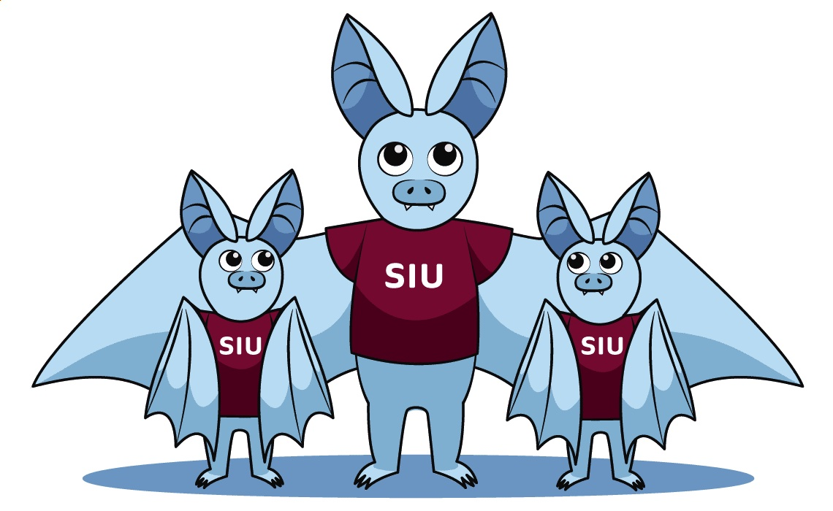
Please complete the Exit survey
Equity ● Quality ● Collaboration ● Community

