Slide 1
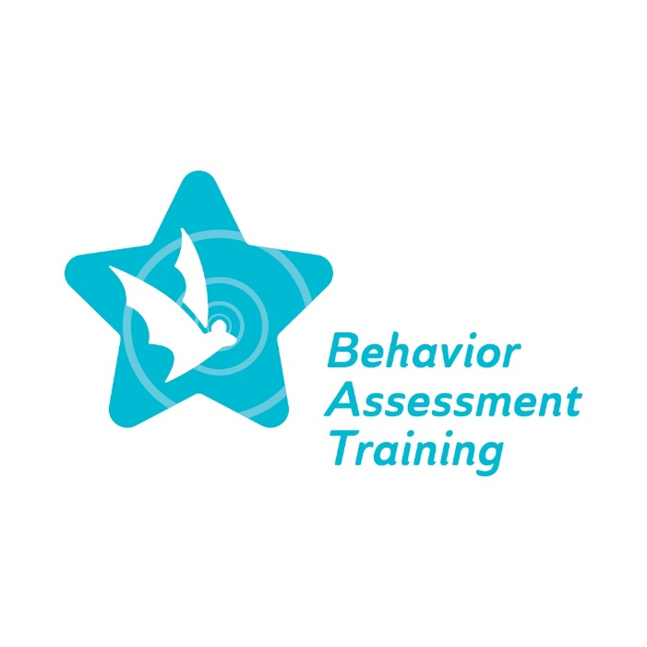
Equity ● Quality ● Collaboration ● Community

Slide 2
Overview of Collaborating with Families, Staff and Community Members
Deborah A. Bruns, Ph.D.
November 29, 2022
Winter Conference
Equity ● Quality ● Collaboration ● Community

Slide 3
Agenda
Welcome
Overview of BAT project
Implicit bias and Behavioral expectations
Family collaboration
Working with staff
Community context and expectations
Self-reflection
Q&A (time permitting)
Exit survey
Equity ● Quality ● Collaboration ● Community

Slide 4
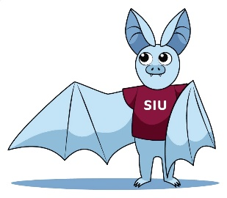
Behavior Assessment Training (BAT) project
The Special Education Behavior Assessment Training Project will provide comprehensive, professional learning for special education personnel on culturally responsive Functional Behavior Assessment (FBA) practices and Behavior Intervention Plans (BIPs) for students across all grade levels identified as having a disability in one or more of the 13 categories specified in IDEA…Additionally, the successful Offeror will coordinate with ISBE on mandate 105 ILCS5/14-8.05, which requires ISBE to develop and implement State-level guidelines on culturally responsive, evidence-based behavior interventions for students across all grade levels identified as having a disability in one or more of the 13 disability categories specified in IDEA.

Slide 5
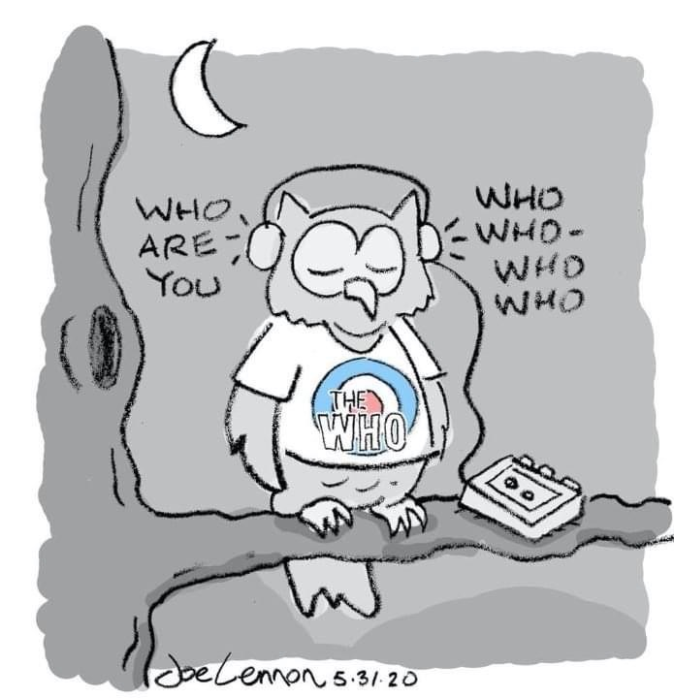
Reviewing Implicit bias
Examine student behavior through a personal, contextual, and professional lens
Awareness of personal lens as a process; much is long- standing and not examined
Explore potential for mismatch in what we bring and what our students bring to the classroom

Slide 6
Articulating types of Implicit bias
Racial bias: Preference for one racial group over another
Gender bias: Preferential treatment toward one gender over another
Affinity bias: Treating people better because they are similar (likes, dislikes, religion, education, etc.)
Name bias: Making judgments about people based on their name
Perception bias: Making judgments about people based on stereotypes or assumptions

Slide 7
Behavioral expectations
Behavioral expectations are broad goals and/or general ways to guide behavior.
Guide how parents and family members would like children to act. Also includes community context, and, potentially, local and regional practices etc.
Guide how teachers would like students to act; often presented as guidelines for behavior for all students across all settings (e.g., Student Code of Conduct).

Slide 8
Behavioral expectations continued
Behavioral expectations are broad goals and/or general ways to guide behavior.
Apply to the adults in school settings including teachers, administrators, related service providers; may not be explicit but expected.
May be a mismatch between community-based expectations mirrored in the school setting and background of staff member or vice versa

Slide 9
Assumptions impact students
School professionals may hold assumptions about students’ learning and behaviors and their capability for academic success which are tied to students’ identities and/or backgrounds, and can impede student growth
Instructors may assume that certain students know to seek help when they are struggling, although students at higher risk for struggling academically are often less likely to seek help and support.
Instructors may assume that students from certain backgrounds or social groups have differing intellectual abilities and/or ambitions. For example, an instructor might assume that a student from a certain background will be satisfied with a lower level of achievement in one or more core subjects.
Instructors may assume that students will best relate to the historical, contemporary, or fictional character who resembles them demographically.
Staats C et al. (2017). State of the Science: Implicit Bias Review 2017. Kirwan Institute for the Study of Race and Ethnicity.

Slide 10
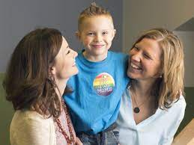
Family collaboration
Learning about views on childrearing, behavioral expectations and disability (all related)
Promoting ongoing, bi-directional communication to understand behavior
Emphasizing the importance of coordination and consistency to address behavioral concerns

Slide 11
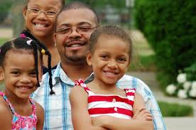
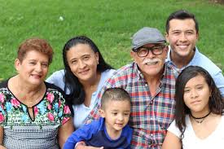
Family collaboration continued
Diverse types of families and potential for bias:
Single
Nuclear
Traditional
Extended
Multigenerational
Widowed
Foster
Adoptive

Slide 12
Family collaboration continued
For educators: Don’t make assumptions. Ask questions and listen to the responses. Educate yourself about the unique needs of your families.
Ask how they envision partnering with you to help their child. Find out how they prefer to communicate (phone, email, face-to-face meeting). And always include an opportunity for families to give you feedback. Good communication is a two-way street. It requires trust, which is built on understanding and mutual respect.
For families: Tell teachers about your child’s strengths, needs, and interests. Share details about your family life and traditions that are important parts of who your child is. Talk about what works for you when you have to support or discipline your child. Be open about any barriers your child is facing, like not having time to complete assignments due to work schedules. Try to work with the teacher to address these issues.
https://www.understood.org/en/articles/black-brown-families-heard-by-school

Slide 13
Working with staff
Interactions between teachers, administrators, aides, and related services professionals
Training and experiences in current building or district compared with other building or district
Expectations for classroom behavior compared with 1:1 sessions and small group (e.g., social skills group)

Slide 14
Working with staff: Actions to consider
Need for intentional professional development
Ongoing opportunities for discussion and planning to explicitly address bias
Review related handbooks, codes of conduct etc.

Slide 15
Working with staff: Restorative justice lens
Respect every person
Build relationships with those around you
Take responsibility for your choices and actions
Repair situations quickly and honestly
Reintegrate into a routine
Maynard, N. & Weinstein, B. (2020). Hacking school discipline: 9 ways to create a culture of empathy & responsibility using restorative justice. Highland Heights, OH: Time 10.

Slide 16
Community context and expectations
Potential differences between community and teachers/administrators
Availability of programs and resources
\for students with behavioral needs and their families

Slide 17
Community context and expectations continued
“Normal”/stereotypical families versus the range of current family compositions including single parents, multigenerational, and two moms or dads
Parents of color and the assumptions regarding disadvantages for children (e.g., do not support education), low socioeconomic status and the like
Children of immigrants, refugees etc. and assumptions
School professionals need to be inclusive and open-minded to those different from themselves

Slide 18
Community context and expectations continued
Community as compared to school based expectations; need to examine for overlap and address differences
Community as compared to individual school based professionals
Consider differences within groups; not only across groups
Families often cannot counteract assumptions and stereotypes (Harry & Klingner, 2022)
Harry, B. & Klingner, J. (2022). Why are so many students of color in special education? Understanding race and disability in schools (Third edition). New York: Teachers College Press.

Slide 19
Social validity
An additional factor to consider related to bias and determining ways to address it is social validity - a behavioral concept.
A few definitions to consider:
Social validity refers to the social significance of intervention goals, social acceptability of intervention procedures, and social importance of their effects.
Social validity is concerned with measuring the impact of treatment goals, procedures, and effects on not only the direct recipients of treatment but also on others that may indirectly influenced by the treatment. Social validity assessment frequently incorporates treatment mediators, family members, friends, peer groups, etc. This inclusion in social validity assessment offers a method for measuring and ensuring that the welfare of others is considered in treatment programs.

Slide 20
Social validity
Need to consider how a strategy, technique, process etc. favored or adopted by one or more individuals may not be socially valid for others who are involved in addressing student behavior concerns
FBAs: a data collection method
BIPs: an intervention to teach replacement behavior
Collaboration with team members
Collaboration with parents and families

Slide 21
Self-reflection
Do I understand the context of the community as related to behavioral expectations including communication styles, preferred interactions etc.?
What is my school’s/program’s/district’s culture as related to behavioral expectations?
Do I recognize the expertise of parents and families?
If yes, how?
If no, why not?

Slide 22
Self-reflection continued
Do I demonstrate respect and understanding for views on behavior different from my own?
If yes, how do I demonstrate this?
If no, what are the first steps to take to demonstrate this?

Slide 24
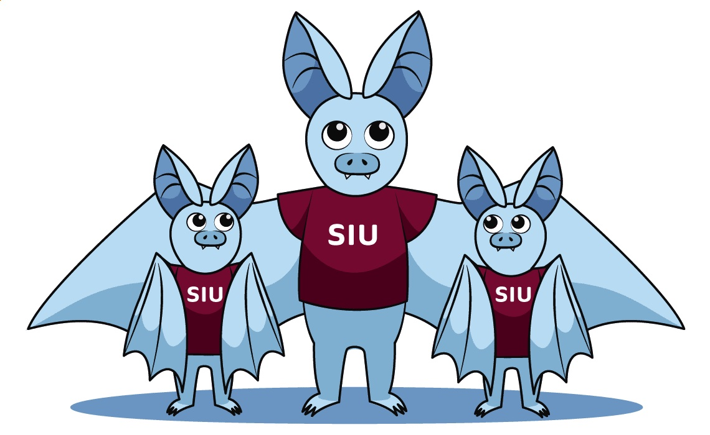
Please complete the Exit survey
Equity ● Quality ● Collaboration ● Community

