Slide 1
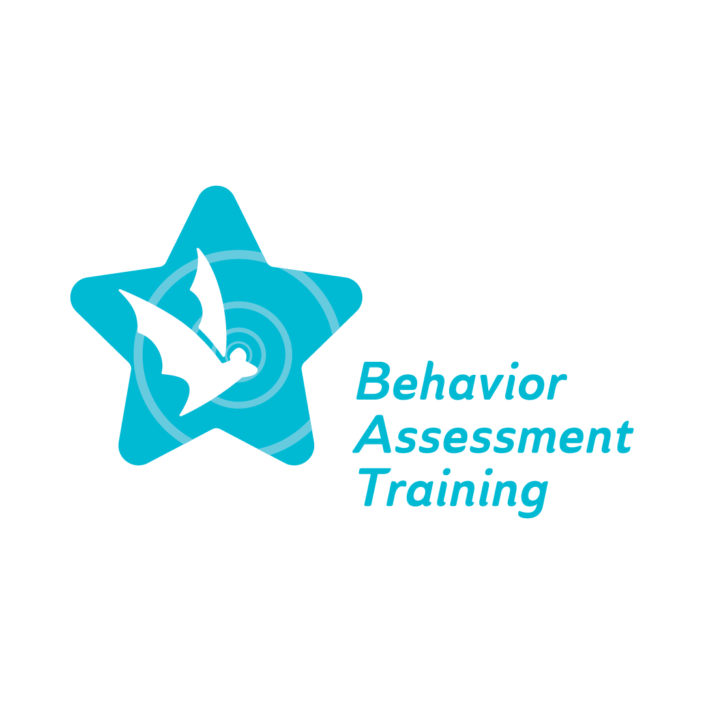
Behavior Assessment Training Fall 2022 Conference
BAT Topic #4

Slide 2
Welcome and Introductions

Slide 3
Audience poll
Special education teacher
General education teacher
Related services personnel
School-site admin
District-level admin
Other

Slide 4
Agenda
About the BAT project
BAT webinar schedule
Preview of Subjects in Topic 4
Significant Behavior Needs
Impact of Trauma and Other Adverse Circumstances
Court involved youth
Early childhood

Slide 5
About the BAT project The Behavior Assessment Training (BAT) project provides professional webinars by content experts on implicit bias, culturally responsive functional behavior assessment (FBA) practices, behavior intervention plans (BIPs), the impact of trauma and other adverse circumstances, family collaboration and early childhood. This project is funded by the Illinois State Board of Education through an IDEA Part B Federal Grant.

Slide 6
BAT webinar schedule
Topic 1
Teacher Bias & Stereotype Awareness
Evaluation & Bias
Legal/Ethical Requirements of FBAs and BIPs
Viewing student behavior through an action plan
Topic 2
CR Evidence-Based Behavior Interventions
CR Evidence-Based FBAs
CR Evidence-Based BIPs
Expanding on major themes
Topic 3
Staff, Community & Family Collaboration
Implementation Fidelity
CR data collection
Summary and general follow up
Topic 4
Significant Behavior Needs
Impact of Trauma and Other Adverse Circumstances
Court involved youth
Early childhood

Slide 7
Trauma Defined
Substance Abuse and Mental Health Services Administration (SAMHSA) defines trauma as “an event, series of events, or set of circumstances that is experienced by an individual as physically and emotionally harmful or threatening and that has lasting adverse effects on the individual’s physical, social, emotional, or spiritual well-being" (SAMHSA, 2012).
Note that it’s not the objective facts that determine whether an event is traumatic, but the person’s subjective emotional experience of the event.
https://www.samhsa.gov/trauma-violence
Notes:
The more frightened and helpless one feels, the more likely he or she has been traumatized” (The ARC, 2011, p. 1). Traumatic experiences can negatively impact the developing brain and are therefore especially impactful when these traumas are experienced in childhood.

Slide 8
Impacts of Trauma
Youth with disabilities experience higher rates of traumatic events than their non-disabled peers.
McDonnell et al (2019) found that children with autism spectrum disorder and learning disabilities have higher risks for maltreatment.
The Spectrum Institute (2013) found that 70% of respondents with disabilities reported being victim of abuse, and of those, 90% had experienced abuse multiple times.
Women with intellectual disabilities who are in relationships “are much more likely to have been sexually assaulted and/or forced into unwanted sexual activity” (Skelly, 2021, p. 2).

Slide 9
Trauma and Behavior
Individuals who have experienced trauma can exhibit behaviors that can be disrupting in school settings, property destruction, noncompliance, aggression, or escape behaviors.
These behaviors can even look like mental health disorders, like obsessive behavior, paranoia, or schizophrenia.
In reality, students are dealing with a form of Post-traumatic Stress Disorder, and should be treated by educators as such.

Slide 10
Being Trauma-informed
Trauma-informed practices are not a specific set of actions, but a rather a set of services, supports, and principles rooted in empathy. Trauma-informed practices shift the focus of interventions from “What’s wrong with you?” to “What happened to you?”.

Slide 11
Discipline
What were your behavioral experiences in school?
How were you punished for disciplinary infractions?
Were there students for whom such measures were not effective? Why might this be the case?

Slide 12
Typical disciplinary responses
Represents an interaction involving student’s behavior and adult’s interpretation/response to it
Can be used to identify students who need intensive levels of behavior support and intervention for high rates of:
Externalizing behavior: acting out such as aggression, self-injury, vandalism
Internalizing behavior: covert behavior such as attentional problems or being withdrawn (non-participation)
Tend to rely on punishment (office referrals, etc.)
Do not often involve teaching new or replacement behaviors

Slide 13
Punitive Discipline Practices | Restorative Discipline Practices
Zero Tolerance Gun possession Bodily violence Drug and alcohol offences Dress code “Defiance” | Restorative justice circles Formal, ongoing As-needed
Exclusionary practices Suspension Expulsion Non-public/alternative settings | Positive Behavior Interventions and Supports (PBIS) Classroom-based positive behavior interventions and supports (PBIS) School-wide PBIS
Punishment Detention Repeated writings Corporal/physical (repeated exercises, hitting/spanking, etc.) Missed recess | Response to intervention (RtI) Academic Behavior-based
Others Not-otherwise specified Mandatory counseling Public shaming Tribal practices | Others Not-otherwise specified Tribal practices

Slide 14
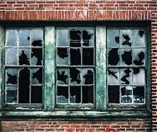
Zero tolerance
Fear-based
Gun violence
“Super predators”
Broken windows theory
Criminology theory of policing
Also referred to quality-of-life or order-maintenance policing
asserts that in communities or schools contending with high levels of disruption, maintaining order not only improves the quality of life, it also reduces opportunities for more serious crimes

Slide 15
Zero-tolerance policies
Hirsman, K. (2020).

Slide 16
Other problems
Increased policing in schools
School-to-prison pipeline
Disproportionately bad for minority students and those with disabilities
Black students represent 31% of school-related arrests.
Black students are suspended and expelled 3 times more than white students.
Students suspended or expelled for a discretionary violation are nearly 3 times more likely to be in contact with the juvenile justice system the following year.
Lack of due process

Slide 17
Impact of typical discipline policies
Long-term educational impacts.
Students who are suspended or expelled are:
more likely to drop out of school
less likely to enroll in higher education.
more likely to have continuing contact with the justice system.
Increased reliance on School Resource Officers (SROs) and the juvenile justice system.
many issues that were once handled at the school level are now handled by law enforcement.
VanderPyl & Yoho, 2019; Hirsman,2020).

Slide 18
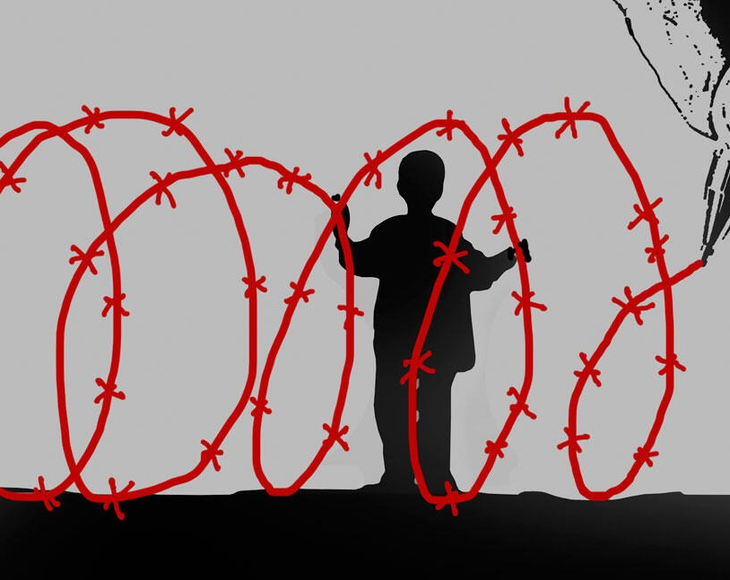
Juvenile Justice Crisis
According to the National Council on Disability, as many as 85% of incarcerated youth have disabilities, making them arguably the most vulnerable population when it comes to school discipline and behavior policies.

Slide 19
School Completion
State of LD report.

Slide 20
Let’s continue the conversation
Louise M. Yoho, PhD
School of Education
223H Wham Hall
Southern Illinois University
Carbondale, IL 62901
louise.yoho@siu.edu

Slide 21
References
Baladerian, N. J.; Coleman, T. F.; Stream, J. (2013). Abuse of people with disabilities – victims and their families speak out – A Report on the 2012 National Survey on Abuse of People with Disabilities. Spectrum Institute Disability and Abuse Project.
Hirshman, K. (2020) Legal issues in school discipline. Loyola University Chicago.
Horowitz, S. H., Rawe, J., & Whittaker, M. C. (2017). The State of Learning Disabilities: Understanding the 1 in 5. New York: National Center for Learning Disabilities.
McDonnell, C.G., Boan, A.D., Bradley, C.C., Seay, K.D., Charles, J.M., & Carpenter, L.A. (2019). Child maltreatment in autism spectrum disorder and intellectual disability: results from a population-based sample. https://doi.org/10.1111/jcpp.12993
National Council on Disability. (2015). Breaking the School-to-Prison Pipeline for students with disabilities. Washington, D.C.: National Council on Disability
Substance Abuse and Mental Health Services Administration. (2012). https://www.samhsa.gov/trauma-violence
Skelly, A. (2012).Trauma informed care and intellectual disability. Learning Disability Today. https://www.learningdisabilitytoday.co.uk/trauma-informed-care-and-intellectual-disability

